Slide 1
In-Service Training – Part B

Slide 2
DEVELOPING DIGITAL SKILLS
This module aims to develop VET tutors digital skills and prepare them to work in online environments.

Slide 3
Learning Outcomes
5. Tools for the development of materials for online learning | 6. Creating videos and quizzes for online teaching | 7. Micro-learning | 8. Designing infographics
Recognise the existing open-source tools for creating online learning resources; Understand the type of resources that can be developed with open-source tools (videos, audio lectures, learning games, infographics, eduzines, etc.) Choose the most appropriate tools for their needs | Use open-source software to create a video lecture or an explainer video Understand the basic functionalities of an open-source video software (e.g. Powtoon) Create quizzes using open-source tools (e.g. Google Forms) | Understand what a mini-learning resources format is (ex. Eduzine) Understand how to create the structure of mini-learning format resources Navigate online to find supporting resources from credible sources | Use open design tools (e.g. Canva) Understand basic principles of design (balance, contrast, proportion, ...) Create QR codesusing online tools (e.g. QR code monkey)
Here you could describe the topic of the section
Here you could describe the topic of the section
Here you could describe the topic of the section

Slide 4
In-service Training – Part B
5.
Tools for the development of materials for online learning
6.
Creating videos and quizzes for online teaching
7.
Micro-learning
8.
Designing Infographics

Slide 5
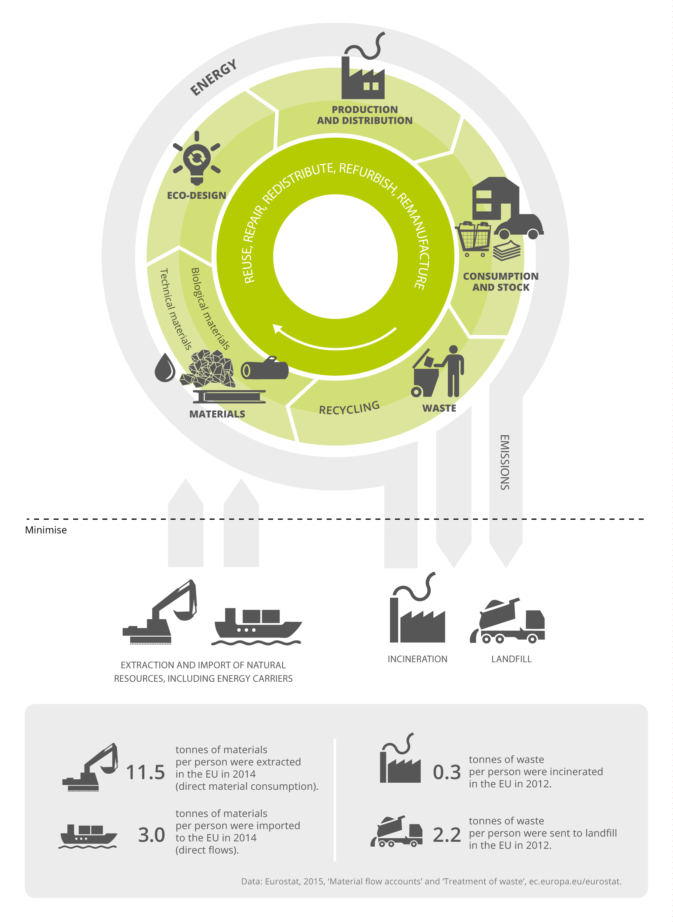
What is an infographic?
An infographic, or informational graphic, is a visual representation of information or data. It is used to quickly communicate a message and to present large amounts of data in a simplistic way.

Slide 6
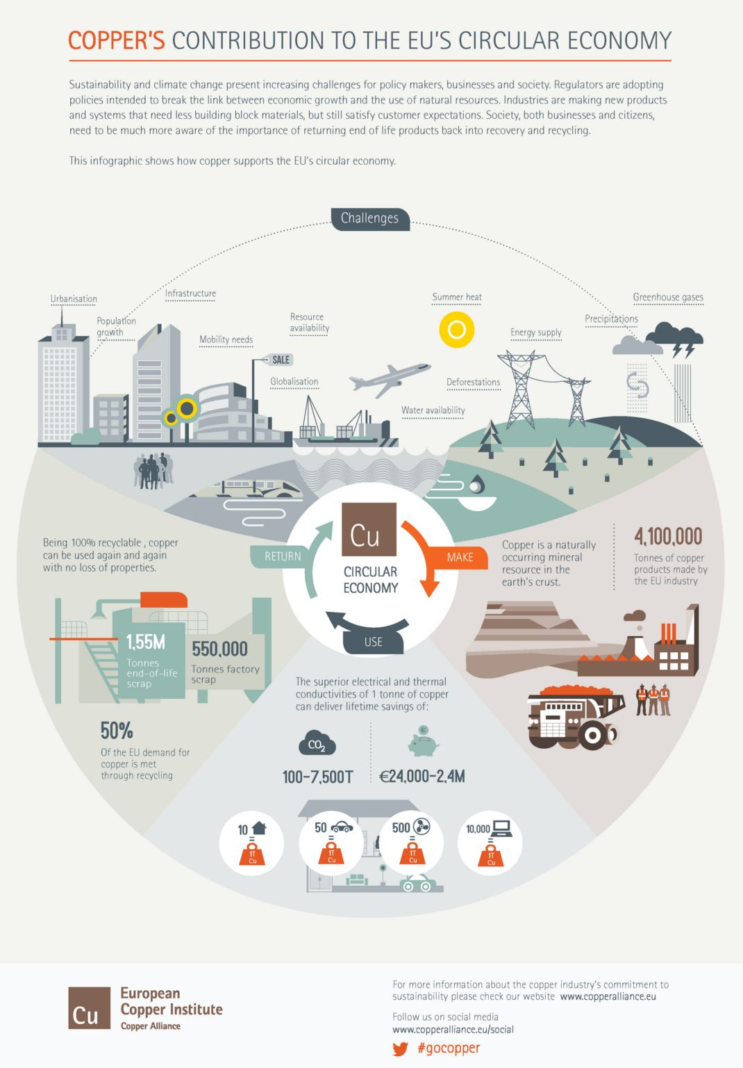
What is an infographic?
Infographics have the ability to transform data into a visual story.
An effective infographic is clear, effective and visually engaging.

Slide 7
Infographics also come in a variety of formats depending on the topic you choose and how you want to share your information.

Slide 8
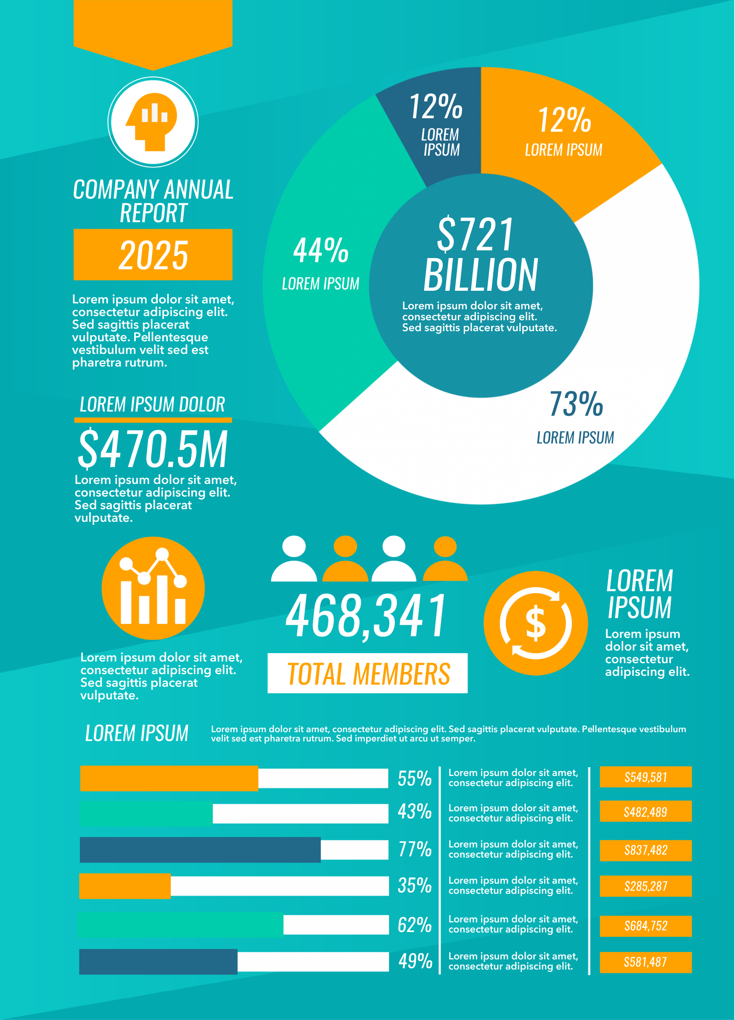
Statistical Infographic
A statistical infographic is ideal for illustrating complex data and information through charts, graphs, diagrams, icons, images and nice fonts. It´s the best option to represent survey data, official data or data from any other sources etc.
It makes data-drive arguments easier to understand as well as facts and statistics more interesting to absorb.

Slide 9
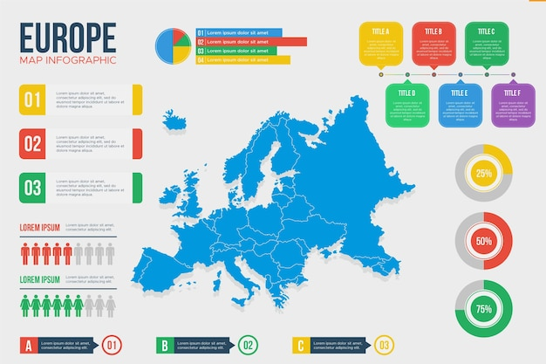
Map Infographic
A map infographic format is ideal for presenting and sharing data trends based on location.
It can be used to compare places and cultures using location-centric data.

Slide 10
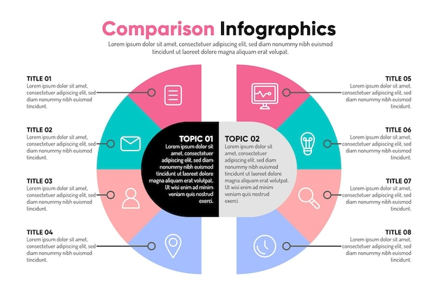
Comparison Infographic
The comparison or versus format infographic format compares two ideas, concepts, or objects.
It is ideal to highlight difference or similarities between two things or to prove one opinion is superior or inferior to the other.

Slide 11
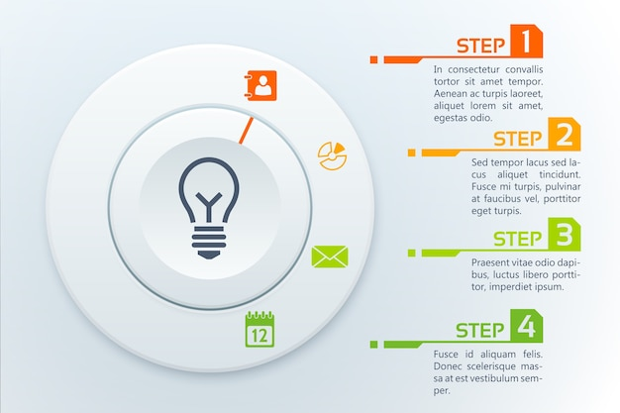
Process Infographic
A process infographic is designed to visualize, summarize and simplify processes. It is the ideal format if your goal is to visualize a procedure, provide a summary of steps in a process or to break down a complex process into easy-to-digest pieces of information.
A process infographic may help learners retain the details of a process or procedure quickly.

Slide 12
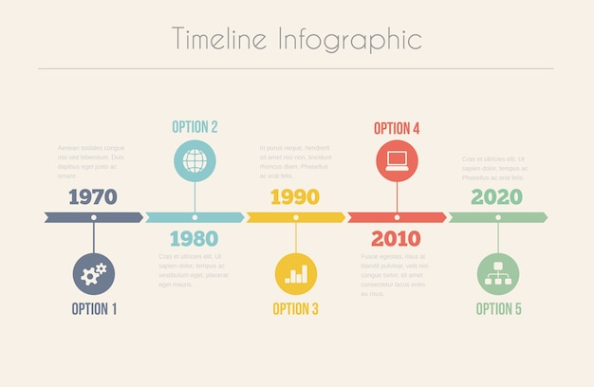
Timeline Infographic
Timeline infographic is ideal when you want to tell a story chronologically or to make a long, complicated story easier to understand.
It can be used to show how something has changed over time, or how one thing leads to another.

Slide 13
Key principles of design
Color – Choose the right combination of colors
Space – Allow your design to breath
Balance – Think symmetrical or asymmetrical
Proximity – Visually connect your elements
Alignment – Think before you place

Slide 14
Color
Color theory is both the science and art of using color. It explains how humans perceive color and the visual effects of how color mix, match or contrast with each other.

Slide 15
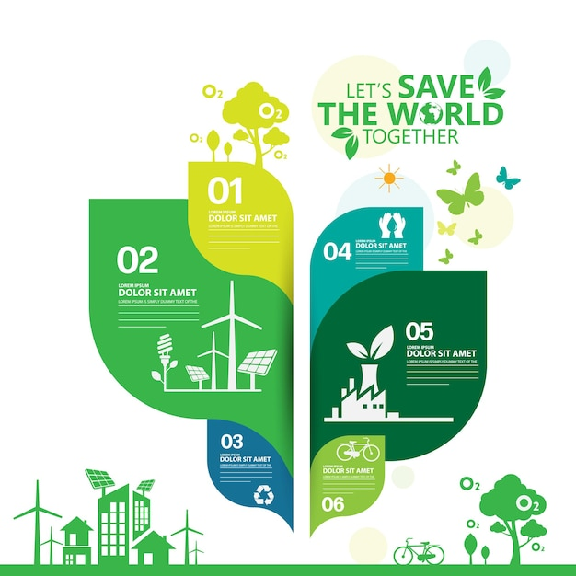
Color
The colors you select should be relevant to the content of the infographic itself. If you talk about Ecology you may want to use shades of green.
Using relevant colors helps the viewer’s mind make the connection and easily understand and retain the data presented.

Slide 16
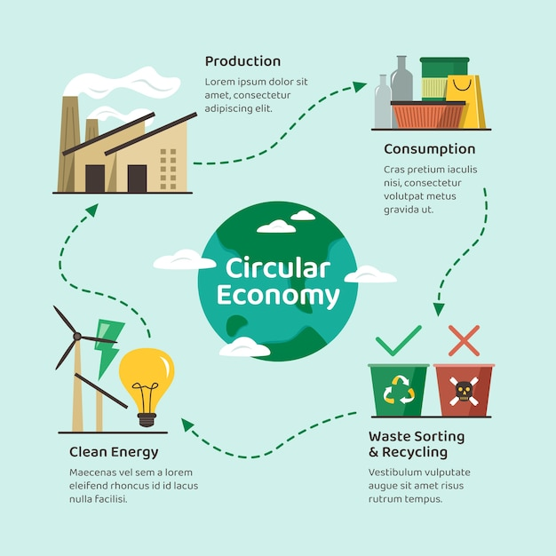
Space
Space in graphic design is the distance around different elements of your composition. It refers to the “empty space” between lines of text, images, icons, and other elements in your infographic.

Slide 17
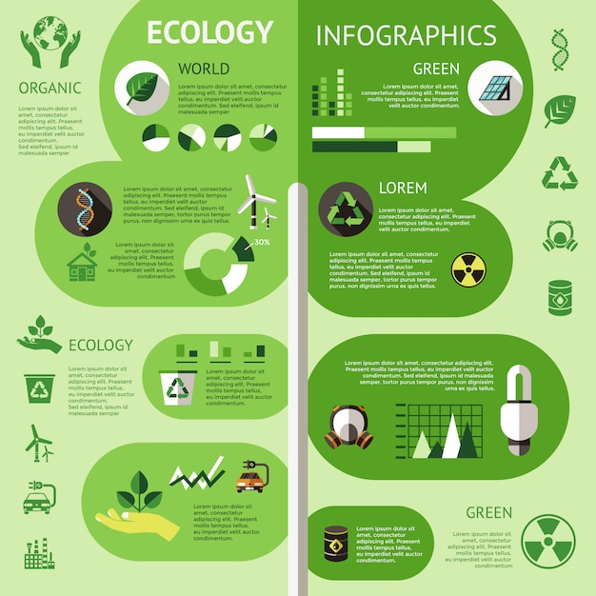
Space
Effective us of space improves readability and comprehension by creating a sense of order and flow and helps ensure that texts are clear and legible.
It is important to make strategic use of space and leave something out when trying to convey a lot of information so that viewers won´t feel overwhelmed.

Slide 18
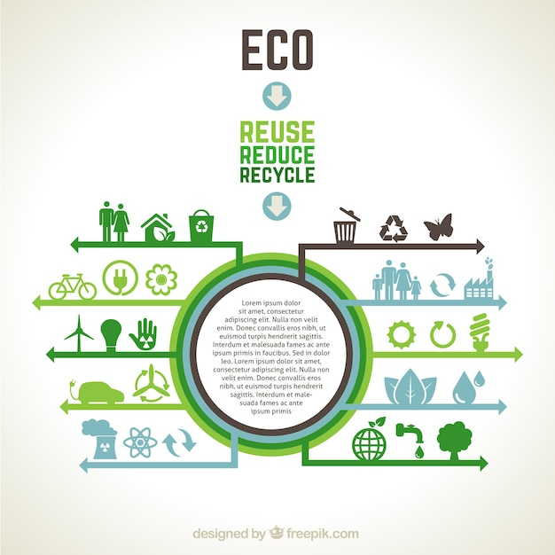
Balance
Balance is the distribution of the visual weight of elements, colors, texture, and space.
Our eyes naturally seek out order and a sense of stability and harmony in any image that we see.

Slide 19
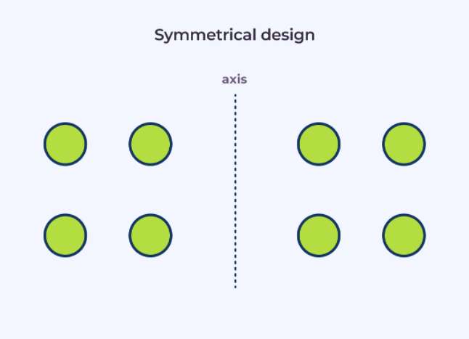
Symmetrical Balance
When both elements of a design have the equal visual weight it is called symmetrical design.
A symmetrically balanced image is visually equal on either side of the center and evokes feelings of order and formality.

Slide 20
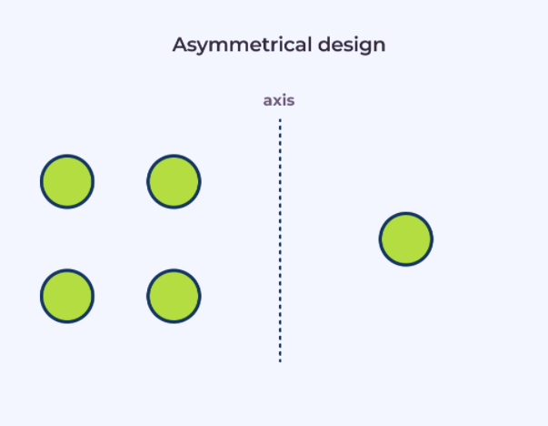
Asymmetrical Balance
Asymmetrical balance is when one element of a picture has a larger visual weight than the other one but you have still achieved a sense of balance.
Asymmetrical design is more dynamic and evokes feelings of movement and vitality.

Slide 21
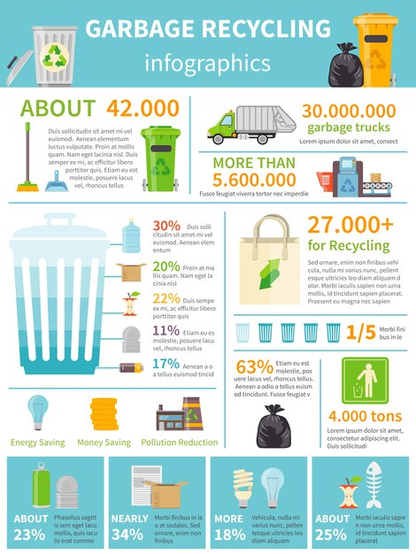
Alignment
Alignment is the organizational placement of text and visual elements so they line up in a composition.
It helps to create order, organize your elements, create visual connections, and improve the readability of your design.

Slide 22
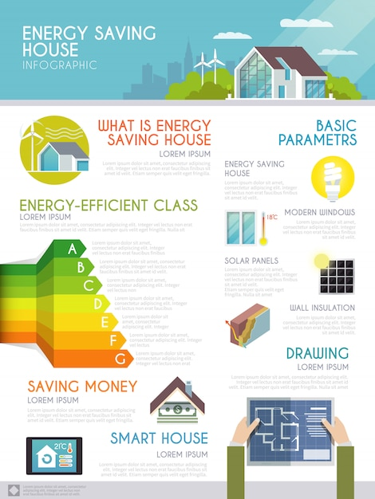
Proximity
Proximity in graphic design refers to the spatial relationship between the elements of the design.
Things that are related should be nearer to each other, and things that are unrelated should be placed further from each other.

Slide 23
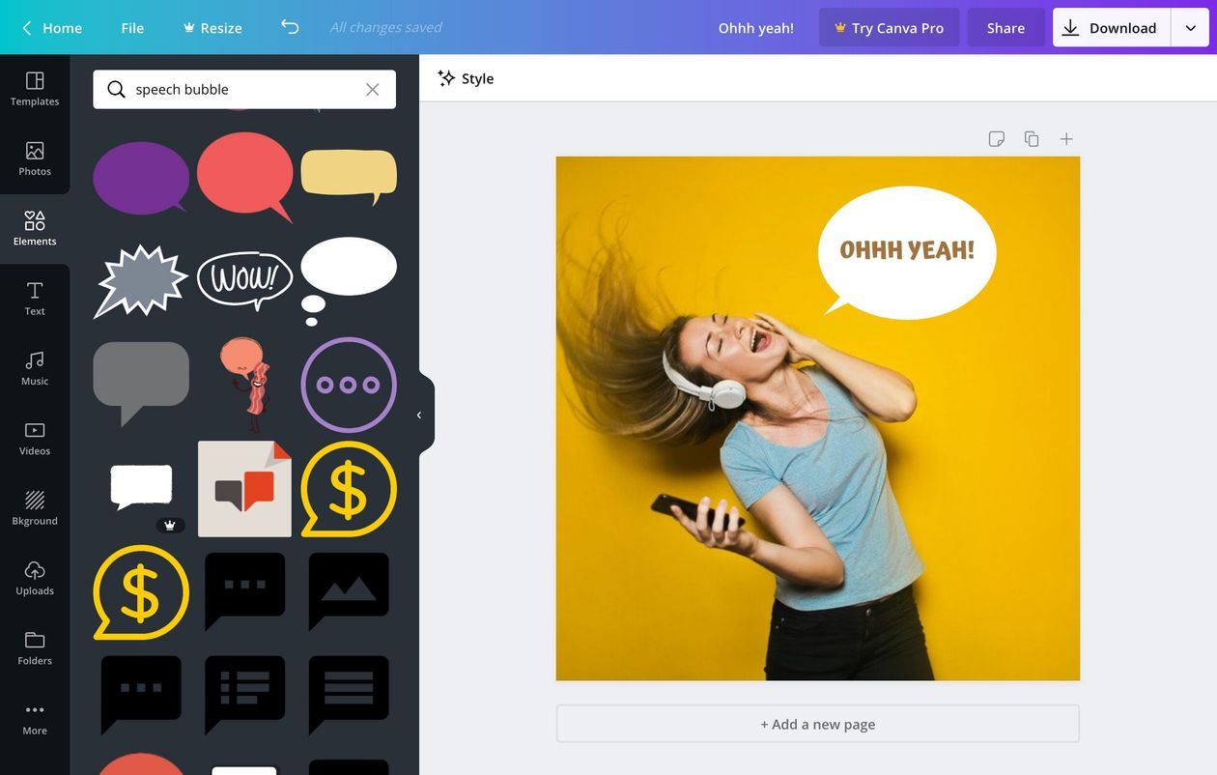
Canva
Canva is a free graphic design tool that allows you to edit and design any graphic content, including posters, logo, flyers, and infographics.

Slide 24
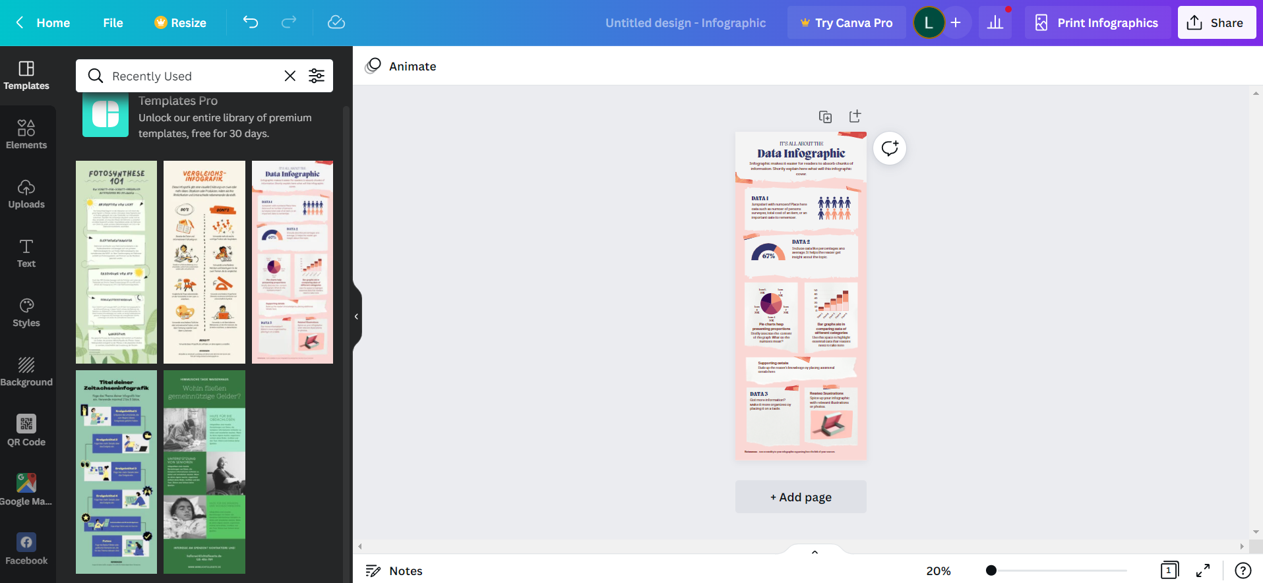
To create an infographic in Canva, you can choose any of the pre-built templates based on your specific needs or start from scratch.

Slide 25
You can add any free stock images, icons and fonts from the Canva´s library or add your own ones.
For any images you want to include but don’t feature on these sites, you can visit a free stock photo site:

Slide 26
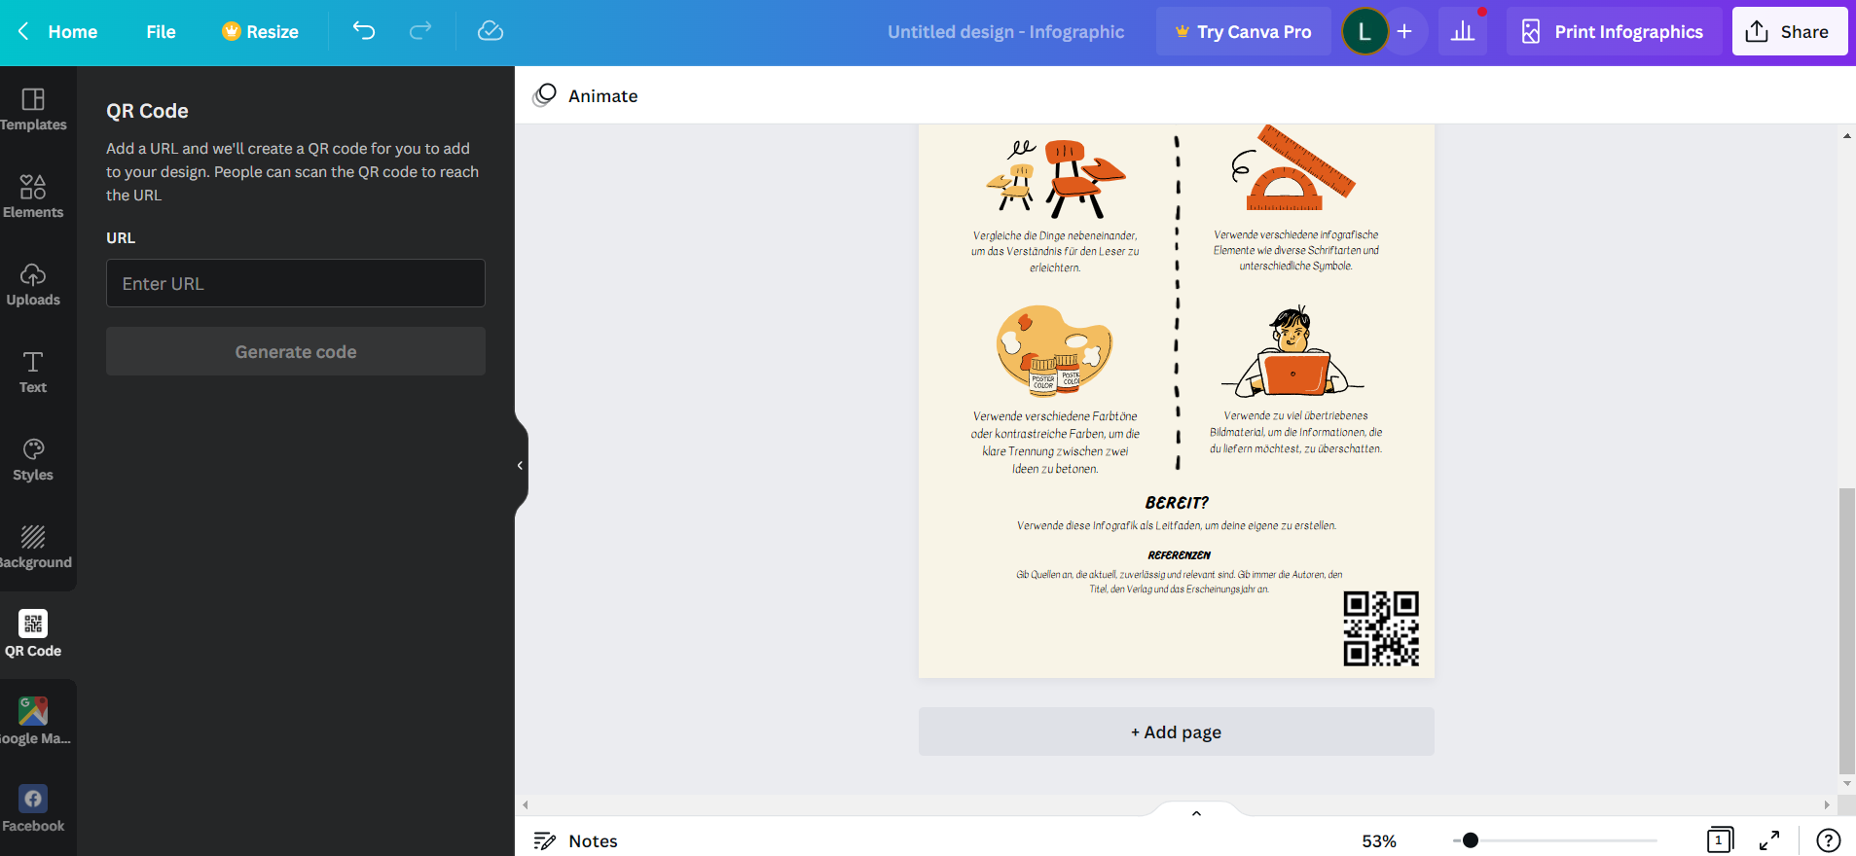
You can also include a QR code in your infographic for any additional resource or further readings.

Slide 27
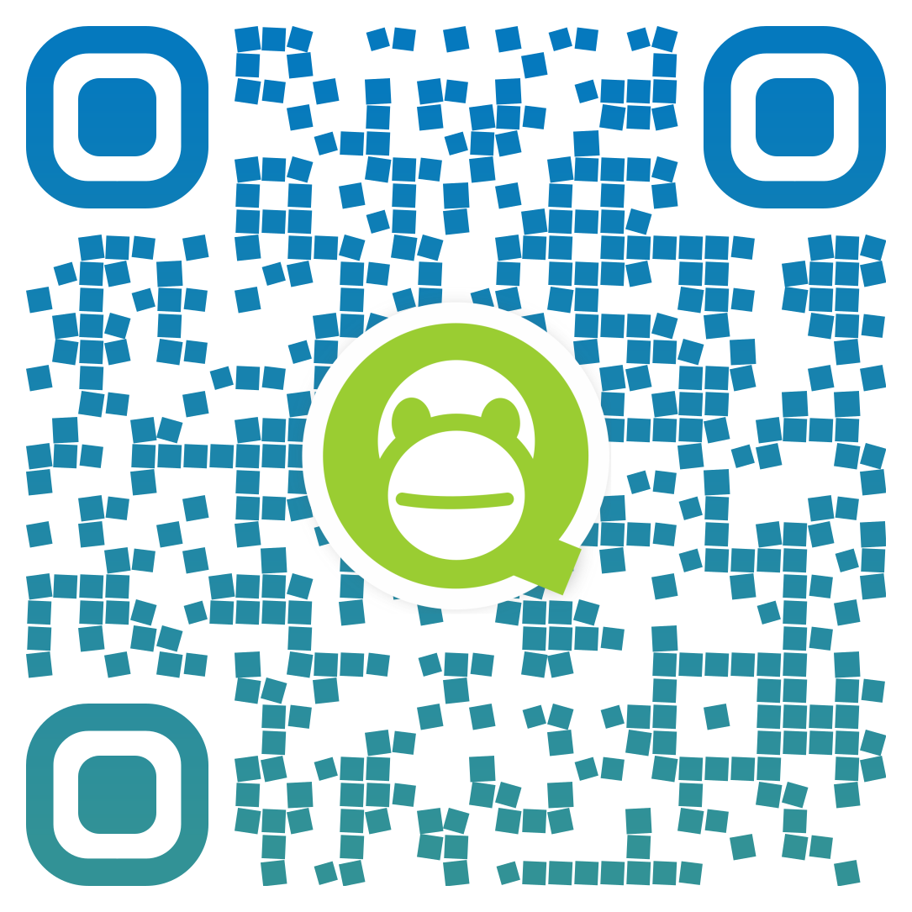
Online QR Code tools
You can use free online QR codes generators to create your own QR code to add on your infographic and provide learners with easy access to links for further readings and resources.
QRCode Monkey is one of the most popular one and allows you to personalize your QR code with logo-images and color-options.

Slide 29
THANK YOU ☺

Slide 30
"The European Commission's support for the production of this publication does not constitute an endorsement of the contents, which reflect the views only of the authors, and the Commission cannot be held responsible for any use which may be made of the information contained therein.” Project Number: 2020-1-UK01-KA226-VET-094435

