Slide 1
In-Service Training – Part B

Slide 2
DEVELOPING DIGITAL SKILLS
This module aims to develop VET tutors digital skills and prepare them to work in online environments.

Slide 3
Learning Outcomes
5. Tools for the development of materials for online learning | 6. Creating videos and quizzes for online teaching | 7. Micro-learning | 8. Designing infographics
Recognise the existing open-source tools for creating online learning resources; Understand the type of resources that can be developed with open-source tools (videos, audio lectures, learning games, infographics, eduzines, etc.) Choose the most appropriate tools for their needs | Use open-source software to create a video lecture or an explainer video Understand the basic functionalities of an open-source video software (e.g. Powtoon) Create quizzes using open-source tools (e.g. Google Forms) | Understand what a mini-learning resources format is (ex. Eduzine) Understand how to create the structure of mini-learning format resources Navigate online to find supporting resources from credible sources | Use open design tools (e.g. Canva) Understand basic principles of design (balance, contrast, proportion, ...) Create QR codesusing online tools (e.g. QR code monkey)
Here you could describe the topic of the section
Here you could describe the topic of the section
Here you could describe the topic of the section

Slide 4
In-service Training – Part B
5.
Tools for the development of materials for online learning
6.
Creating videos and quizzes for online teaching
7.
Micro-learning
8.
Designing Infographics

Slide 5
Micro-learning
Micro Learning refers to learning material that are targeted, specific to the learner´s training need and interested and delivered in short snippets or bite-sized formats.

Slide 6
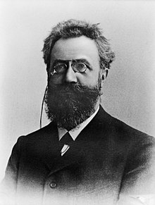
Memory retention
In the mid 1880s, the German psychologist Hermann Ebbinghaus pioneered the experimental study of memory. He mostly focused on understanding how our memory works, and retains information, relating to specific things people attempt to learn.

Slide 7
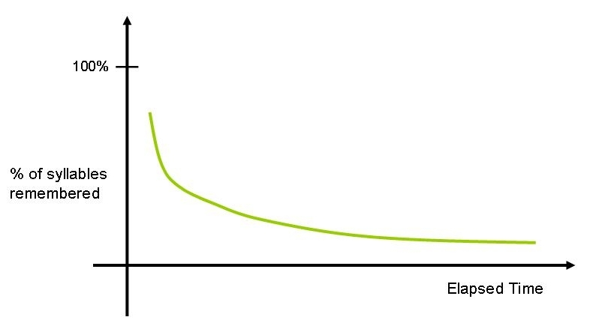
Memory retention
Hermann Ebbinghaus' tests involved memorizing series of nonsense sounds and syllables, and assessing the capabilities and function of memory.
Ebbinghaus noted that memory does not stay consistent, it can increase, decrease, and come back again many times.

Slide 8
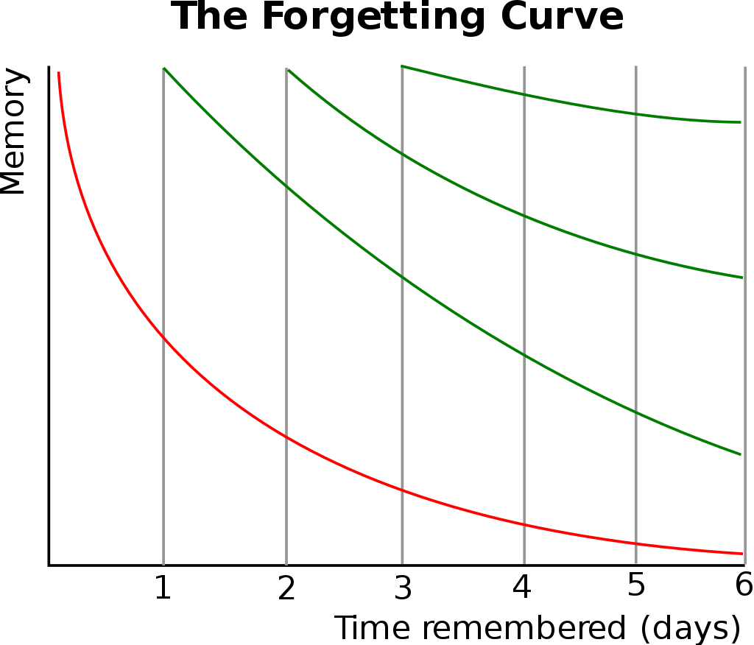
Memory retention
The Ebbinghaus’ forgetting curve shows how information is lost over time when there is no attempt to retain it. When someone first learns something, they retain all of that information. As the days pass, memory retention begins to drop.

Slide 9
Memory retention
When people learn large amounts of information, they do retain it for a certain amount of time.
However, if that information isn’t considered ‘crucial’ to the tasks at hand, the knowledge tends to degrade over time. But as you perpetually review information, you retain more and more of it.

Slide 10
The forgetting curve
This also led to the discovery of memory “savings”. He found that strictly memorized information can be recalled much more easily after learning it again, even after a long time.

Slide 11
Micro-learning
Microlearning is the concept at the basis of Ebbinghaus´ studies and comes as a solution to flatten the forgetting curve.
Splitting the content into small pieces and recalling different parts of it over time can help improve knowledge retention and productivity.

Slide 12
Mini-learning format resources
Mini-learning format resources are typically digital resources that are available online through web platforms or smart devices so that learners can access materials at a time and place that is convenient to them.

Slide 13
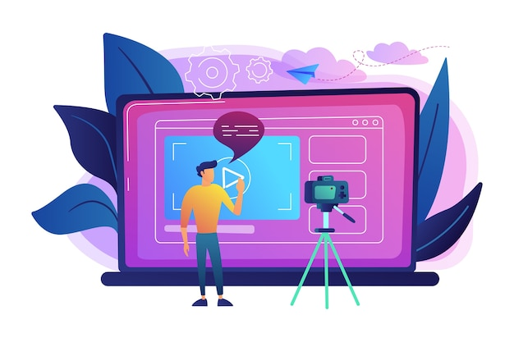
Videos

Slide 14
Learning Games

Slide 15
Audio lectures

Slide 16
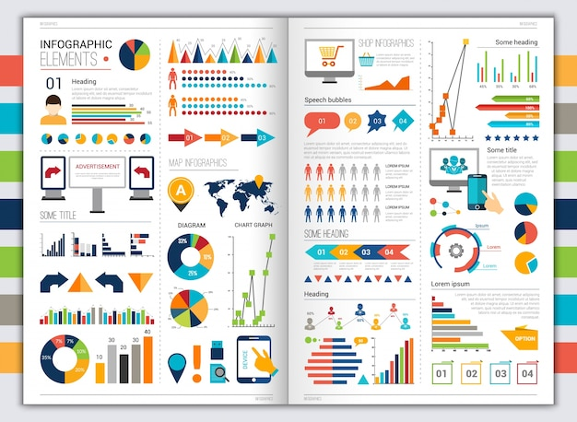
Infographics

Slide 17
Mini-learning format resources are short in duration and format and are developed based on defined learning outcomes to deliver targeted education content to learners.

Slide 18
Structure of a Mini-Learning Format Resource (MLFR)
When creating a mini-learning resource, the following structure should be adhered to.
This structure is based on common approaches used in teaching settings and is informed by didactical principles and learning theory.
Introduction & Aims
Key Learning Content
Reflection & Transfer

Slide 19
Structure of a Mini-Learning Format Resource (MLFR)
Phase 1 – Introduction & Aims
The input time for this phase should last approx. 1-2 minute and it should include:
Title of the resource
The learning outcome(s)
The main content areas of the course

Slide 20
Structure of a Mini-Learning Format Resource (MLFR)
Phase 2 – Key Learning Content
This phase is the core element of the resource and will be the most extensive phase.
The input time for this phase should be approx. 3-4 minutes and it should include the actual learning content that targets a very specific problem context or thematic issue.

Slide 21
Structure of a Mini-Learning Format Resource (MLFR)
Phase 3 – Reflection & Transfer
The input time for this phase should be approx. 1 minute and should include:
Short summary of the key learning points
Questions or statements to help the learner reflect the content

Slide 22
Structure of a Mini-Learning Format Resource (MLFR)
After Phase 3, you have the option to provide self-assessment tasks, resources and/or quiz to help test the knowledge.
Following this structure, will help you:
Keep high standard of quality, consistency and relevance
Deliver focused learning resources

Slide 23
Principles for developing a Mini-Learning Format Resource (MLFR)
From a didactical perspective, content should be:
Problem-oriented: theoretical content should have a corresponding practical context to help learners understand the learning content and reflect it.
Competency-oriented: content should be aimed to acquire a specific competence.

Slide 24
Principles for developing a Mini-Learning Format Resource (MLFR)
Complement: the acquired knowledge should not only be reflected, but also complemented, extended and deepened. It is recommended to link the created resources with similar ones.
Practical: to acquire competences these need to be practiced so exercises should be given or embedded into the resource.

Slide 25
Key design principles
Goal definition: define clear learning goal
Coherence: exclude not relevant information
Redundancy: do not present the same information twice
Spacial contiguity: place corresponding information near to each other
Temporal contiguity: present corresponding information simultaneously
Multimediality: combine words and pictures
Personalisation: convey text and words in a friendly and conversational style

Slide 26
What you need to develop a mini-Learning Format Resource
For a resource that is 5-7 minutes in length, you will need:
Script of 450-600 words
PowerPoint Presentation with 8-10 slides
Include mostly images and graphs – as little text as possible on the slides

Slide 27
Eduzines
An EduZine is an educational magazine for smartphone use (and all other digital devices) with embedded media and learning content. The formulation of this format is an innovation in terms of the presentation of learning content.

Slide 28
EduZines are structured according to the following 5 stage learning model:
An explainer video to introduce the topic (ex. Ted Talk)
Prior knowledge assessment - a diagnostic quiz or puzzle to help the learner identify what they already know, developed using Google Forms or other such platform or tool.
Learning material – core learning content with theoretical knowledge and challenged-based activities that will help the learner acquire new knowledge. It culminates with a presentation or submission of an exercise.
Peer assessment - an online peer assessment where presentations, videos or submissions are commented on by fellow learners.
Validation - a summary quiz that leads to a digital certificate and an opportunity for self-reflection.

Slide 29
Format of an Eduzine
The typical EduZine will have the following layout:
Page 1 – Front page
Page 2 – Introduction page
Page 3 – Index
Page 4 – Expected learning outcomes
Page 5 – Self reflection exercise
Page 6 – Page 17 – Content
Page 18 – Final Task
Page 19 – Final test
Page 20 – Further resources

Slide 30
Introduction Page and Index
The Introductory page will include a short video lecture (2-3 minutes) that will act as an introduction to the topic for the entire module that will be presented through the EduZine.
The explainer video should be accompanied by a short overview and introduction to the video. This short piece of text (maximum 100 words), should present an introduction to the video and to the module, lightly detailing what will be covered in both.

Slide 31
Expected learning outcomes
It contains the learning outcomes that will be addressed in the Eduzine.
It should try to address 2-3 learning outcomes for each part of the learning outcomes matric (knowledge, skills, attitudes).

Slide 32
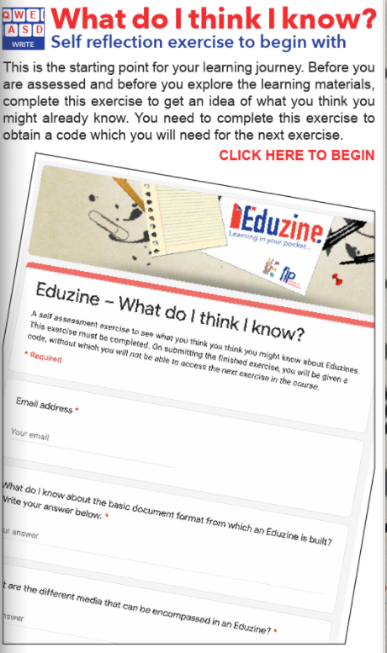
Self-reflection exercise
The self-reflection contains a short quiz of 8-10 questions that will offer some multiple-choice questions with key definitions, theories, models and techniques that are linked to the topic of the EduZine.
The aim of this self-reflection exercise is to test learners´ knowledge of the topic, before they start their learning. It is a way of assessing what learners know at the start of their learning process and track their progress when they repeat their assessment at the end of the program.

Slide 33
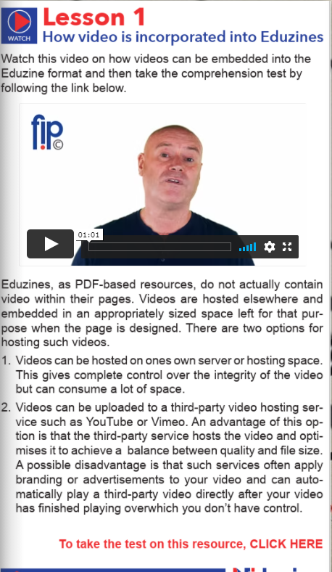
Content Section
This section of the EduZine comprises the core learning content of the EduZine programme and it should be max. 10 pages. These 10 pages should comprise short articles that deliver the learning content directly to the learner.
Due to the format of the EduZine, each page has a maximum of 250 words, without an image. Pages with an image have a maximum of 150 words per page.

Slide 34
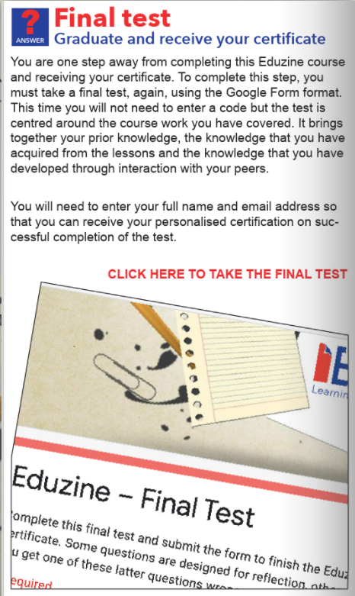
Final Test
The final test in the EduZine constitutes another ‘test your knowledge’ quiz for learners to complete.
The questions come directly from the content presented in the articles, as a means of reinforcing the learning presented in the EduZine.

Slide 35
Further resources
The final pages in the EduZine will comprise some additional learning and reading materials which learners can use in their self-directed learning to further their knowledge on the topic of the EduZine.
These additional resources can include links to blogs, other articles, YouTube videos (provided subtitles are available in all partner languages), case studies etc.
https://smartzines.com/eduzine/mobile/index.html

Slide 36
THANK YOU ☺

Slide 37
"The European Commission's support for the production of this publication does not constitute an endorsement of the contents, which reflect the views only of the authors, and the Commission cannot be held responsible for any use which may be made of the information contained therein.” Project Number: 2020-1-UK01-KA226-VET-094435

