Slide 1
In-Service Training – Part B

Slide 2
DEVELOPING DIGITAL SKILLS
This module aims to develop VET tutors digital skills and prepare them to work in online environments.

Slide 3
Learning Outcomes
5. Tools for the development of materials for online learning | 6. Creating videos and quizzes for online teaching | 7. Micro-learning | 8. Designing infographics
Recognise the existing open-source tools for creating online learning resources; Understand the type of resources that can be developed with open-source tools (videos, audio lectures, learning games, infographics, eduzines, etc.) Choose the most appropriate tools for their needs | Use open-source software to create a video lecture or an explainer video Understand the basic functionalities of an open-source video software (e.g. Powtoon) Create quizzes using open-source tools (e.g. Google Forms) | Understand what a mini-learning resources format is (ex. Eduzine) Understand how to create the structure of mini-learning format resources Navigate online to find supporting resources from credible sources | Use open design tools (e.g. Canva) Understand basic principles of design (balance, contrast, proportion, ...) Create QR codesusing online tools (e.g. QR code monkey)
Here you could describe the topic of the section
Here you could describe the topic of the section
Here you could describe the topic of the section

Slide 4
In-service Training – Part B
5.
Tools for the development of materials for online learning
6.
Creating videos and quizzes
7.
Micro-learning
8.
Designing Infographics

Slide 5
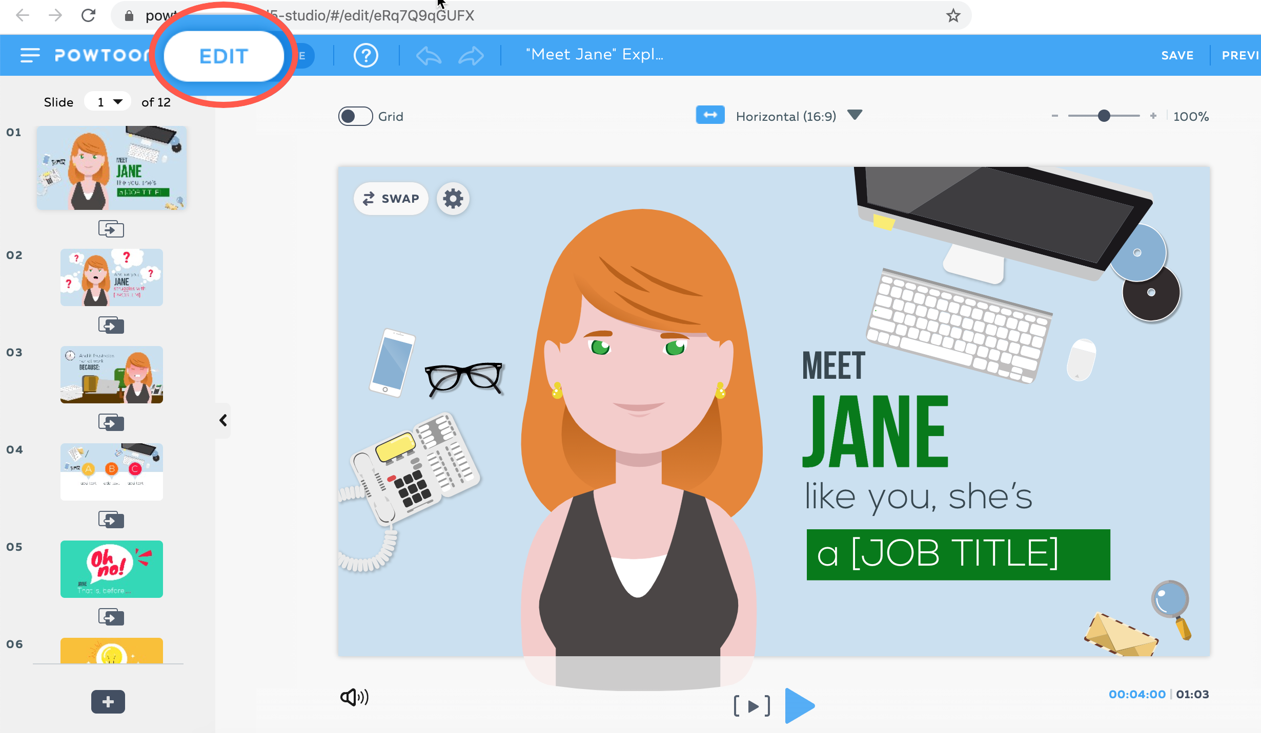
Powtoon
Powtoon is a free to use online tool that allows you to create animated explainer videos using professionally-designed templates, scenes, charachters, videos, soundtracks, text and many other elements.
Here you could describe the topic of the section
Here you could describe the topic of the section

Slide 6
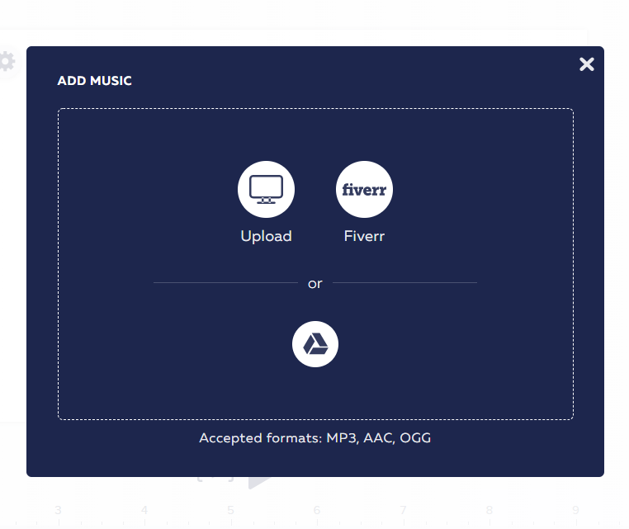
You can choose any of the free to use music available from the library, or upload your own one.
Here you could describe the topic of the section

Slide 7
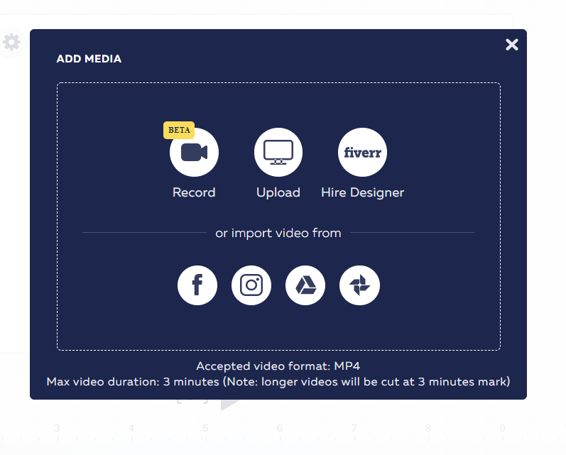
You can even add your own videos or record your screen & webcam.
Here you could describe the topic of the section
Here you could describe the topic of the section

Slide 8
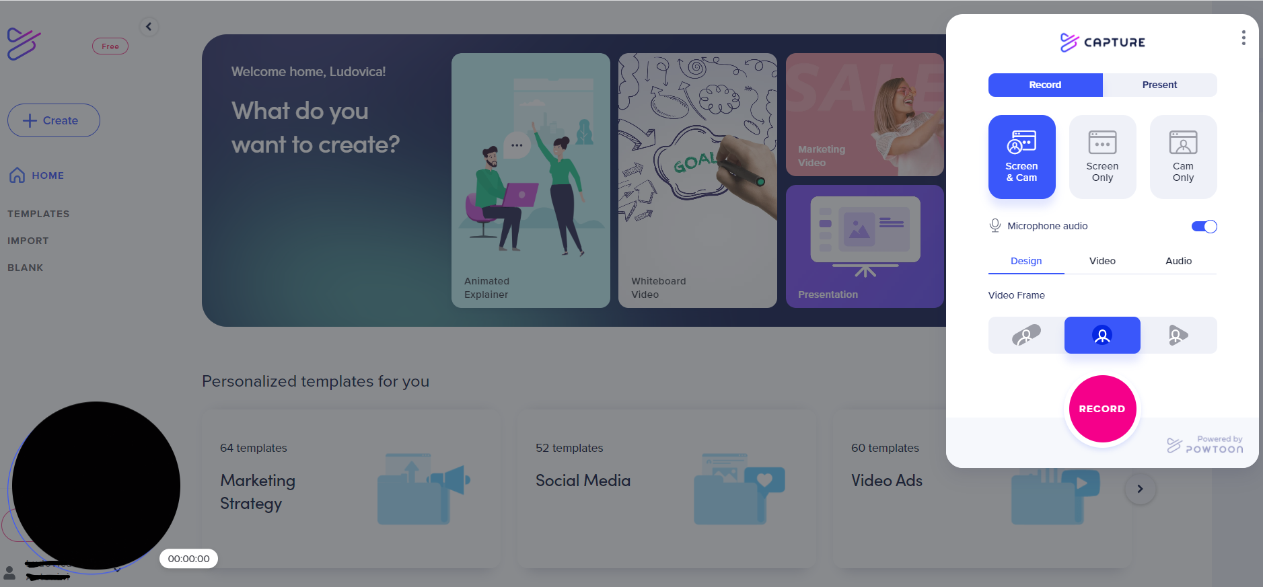
You can either choose to record both your screen & webcam, or webcam or cam only.
Here you could describe the topic of the section

Slide 9
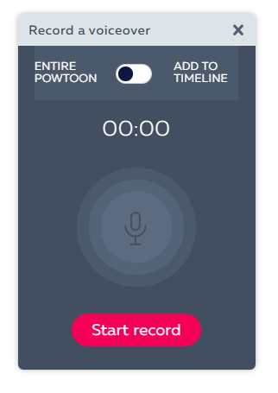
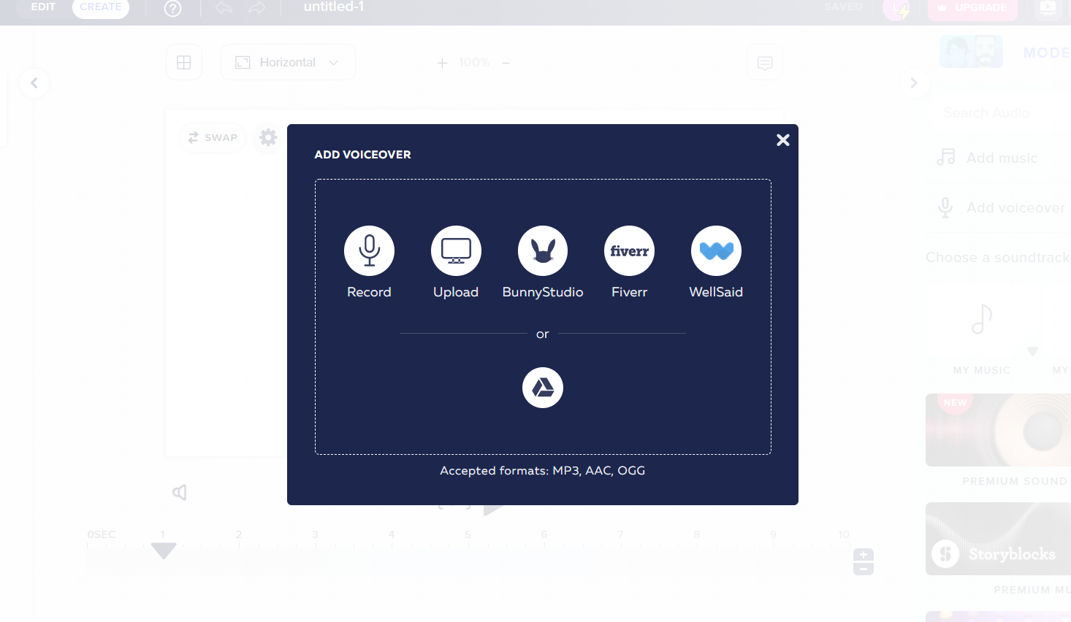
Or add your own voiceover!
Here you could describe the topic of the section
Here you could describe the topic of the section

Slide 10
Here you could describe the topic of the section
Here you could describe the topic of the section

Slide 11
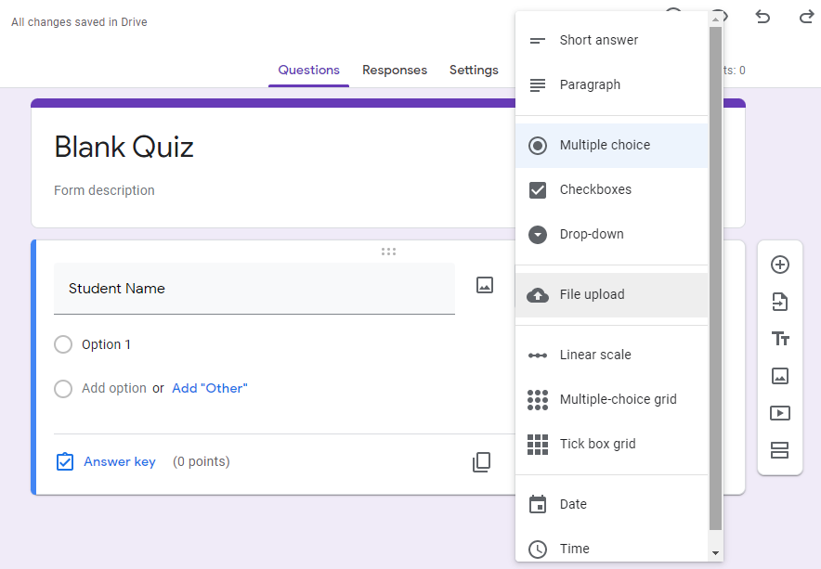
Google Forms
Google Forms allows you to create quizzes and to choose different types of questions, as well as to collaboratively edit and share the forms with other people.
You can specify correct answers, points, and give feedback for correct and incorrect responses.

Slide 12
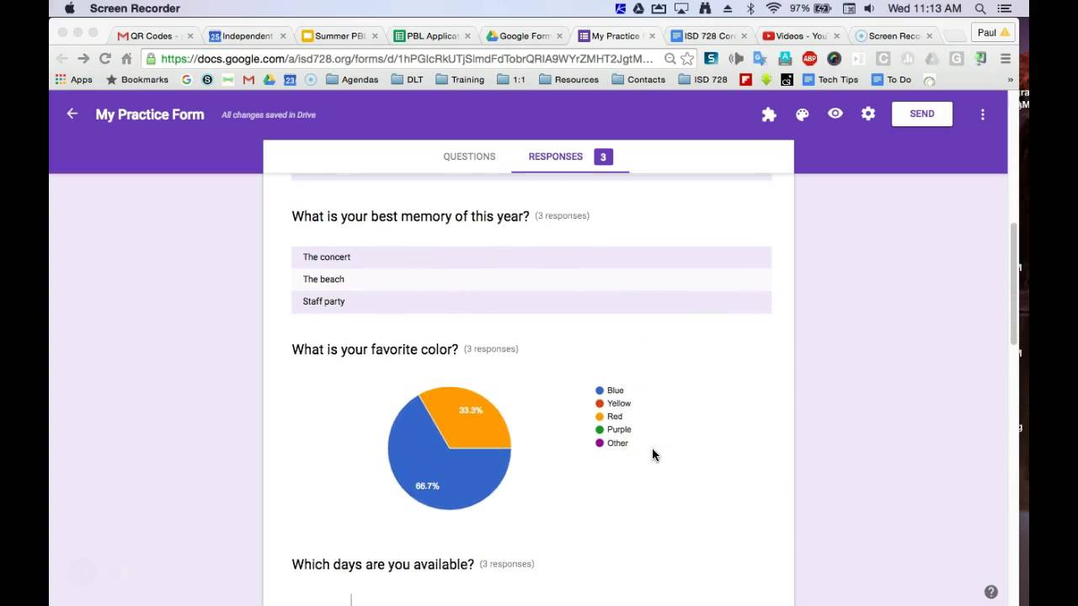
You can quickly access learners´results and identify frequently missed questions that need further review in the response summary.

Slide 14
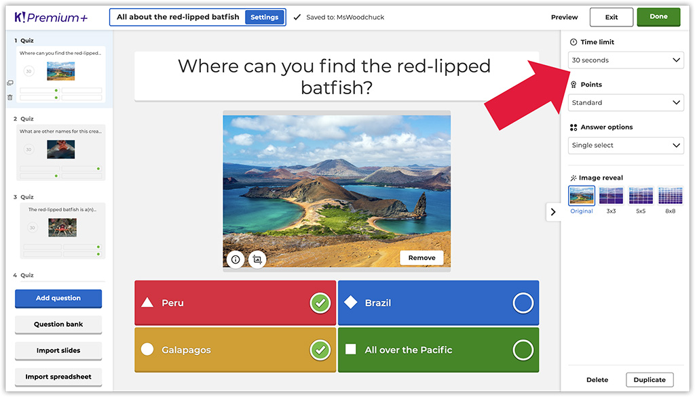
Kahoot
Kahoot! is a free game-based learning platform that allows teachers to create, share and play interactive quizzes.
You can add award points, set a time limit, or accompany your questions with images and videos to add more interactivity.

Slide 15
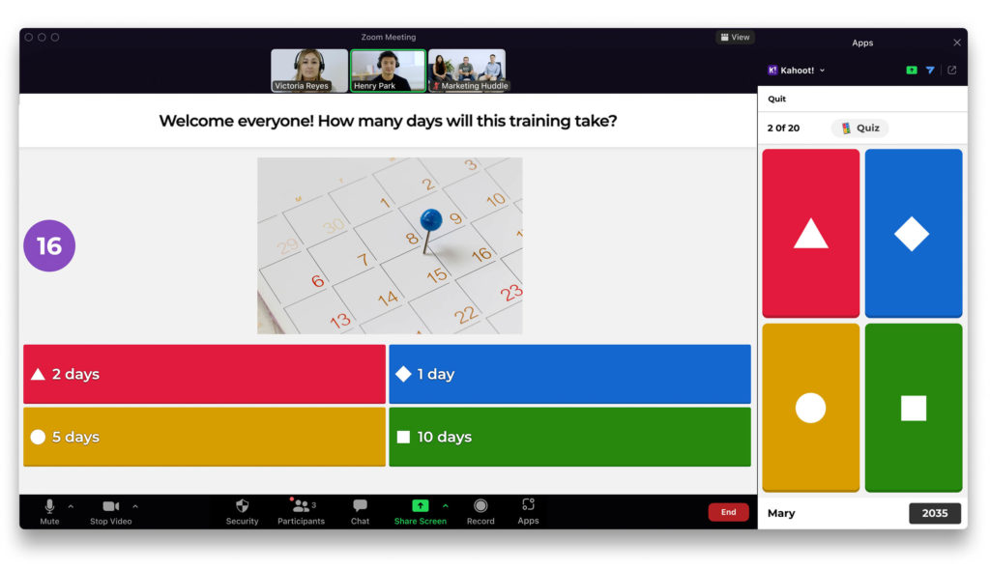
The players will need a PC to view the questions (run the video conferencing app), as well as their mobile phone to use as a controller.

Slide 16
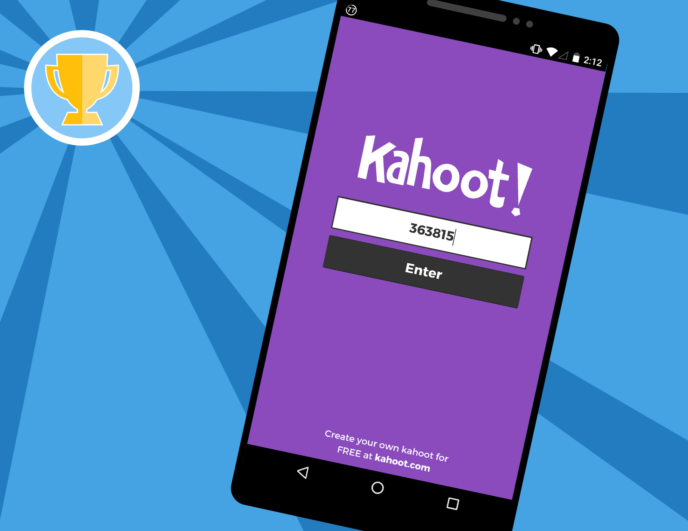
Quiz can be accessed through the Kahoot Game-PIN or by scanning the quiz QR code

Slide 17
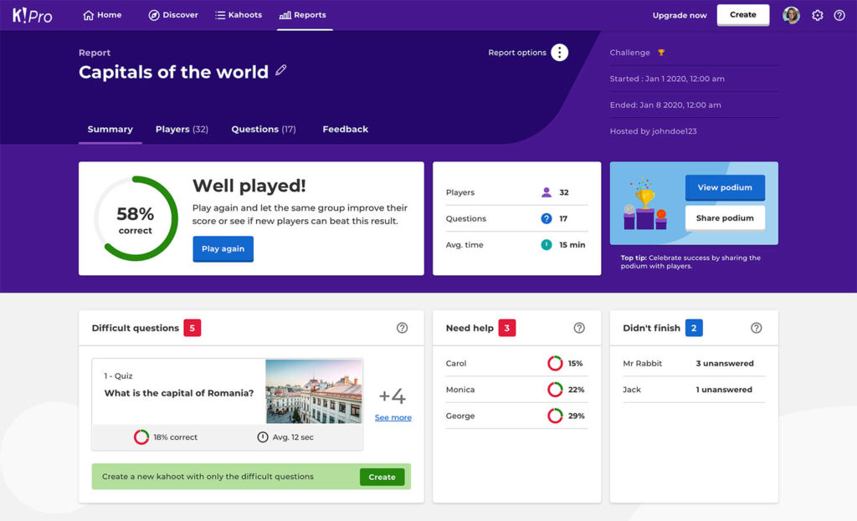
Teachers can also review results and run analytics from game reports for formative assessments so as to better judge progress being made in the class.

Slide 18
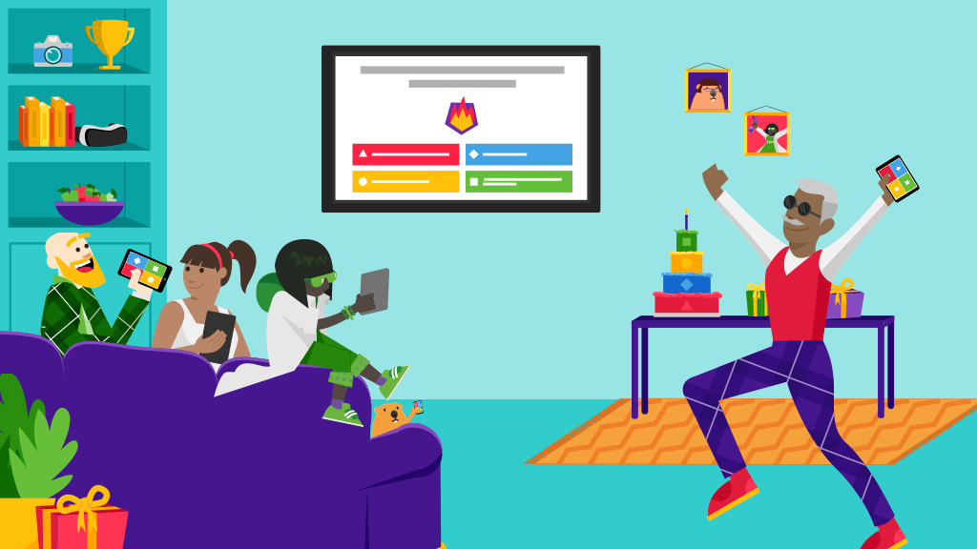
Kahoot is ideal for hybrid learning and flipped classroom situations by making learning fun and engaging.

Slide 20
THANK YOU!

Slide 21
"The European Commission's support for the production of this publication does not constitute an endorsement of the contents, which reflect the views only of the authors, and the Commission cannot be held responsible for any use which may be made of the information contained therein.” Project Number: 2020-1-UK01-KA226-VET-094435

