Slide 1
IO1: In-service Training Programme Module 6: How to build a business plan – PPT2

Slide 2
Module 6: Contents
Business Model Canvas and Social Business Model Canvas
1
Business Plan, Importance and Drafting
2

Slide 3
OBJECTIVES
KNOW
UNDERSTAND
KNOW
Know the definition, the characteristics and the reasons of preparing a business plan
­Understand the importance of preparing a business plan
Know the steps of preparing a business plan

Slide 4
What is a Business Plan?
It is a comprehensive and structured document on how an organisation is planning to achieve its goals and ultimately align its products and/or services with its mission and vision.
Think of it as a documented roadmap, which provides directions as well as a point of reference to organisations, during the process of converting an idea into a viable product or service.
Usually, business plans cover the next one to three years and outline the current and desirable position of the organisation as well as the marketing, financial, and operational aspect of delivering the new product and/or service in the market.

Slide 5
Real Life Example
Let us take the example of preparing for a road trip; you need to plan it in advance, to have a map at your disposal to be your reference and guidance, to determine the final destination beforehand, and decide on the what, how and when you are going to go.
If this preparation is not performed in advance, then there is the risk that you will end up asking the locals for directions, along the way.
Think of a business plan as a road map; you can still travel without it, however the possibility of getting lost is higher.

Slide 6
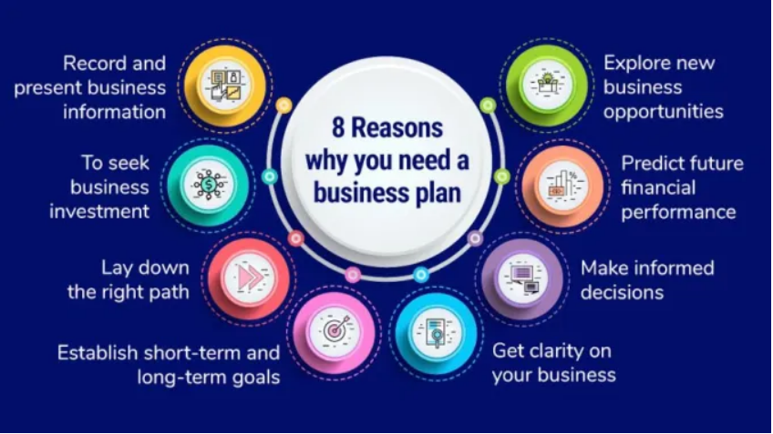
Why is writing a Business Plan important?
Benjamin Franklin, the Founding Father of the United States, once said “If you fail to plan, you are planning to fail”.
Watch this video: https://www.youtube.com/watch?time_continue=327&v=E6N5Trv8pfQ&feature=emb_title
Questions:
Why is writing a Business Plan important?
What are the purposes of writing a Business Plan? Is it only for the interest of internal or external parties?
Source: https://onhike.com/writing-your-business-plan-dont-forget-your-own-professional-development/130724/

Slide 7
The importance of writing a Business Plan
Better decision making
Having a well-documented plan helps the organisation to make critical decisions ahead of time and hence avoid a crisis. Answering questions such as “what” and “how” the product/service will be launched and performing exercises such as revenue and expense projections need to be determined from an early stage. These actions will provide solid insights, articulate the vision in realistic terms and identify gaps in the overall strategy for the organisation to take timely remedies and decisions.
Providing feedback on your business idea
It provides constructive feedback to organisations for formulating and executing their ideas. They can assess their current resources (monetary and non-monetary), i.e. whether capital is required externally, whether more workforce will need to be employed.
Keeping tracking
Business plans can be the best way of keeping an organisation accountable to its long-term vision and strategy in all levels of the organisations, not just the senior management. Business plans should include SMART goals and benchmarks, which help organisations understand whether they are heading in the right direction.
Support into the financing process
Organisations, who plan to obtain external financing, need to be well prepared for their business presentation. Therefore, need to have a concise business plan. Banks and investors want to know where the organisation stands as at the date of the pitch and how viable is the proposed idea. Having a business plan increases the likelihood of getting funded by 2.5x times more.

Slide 8
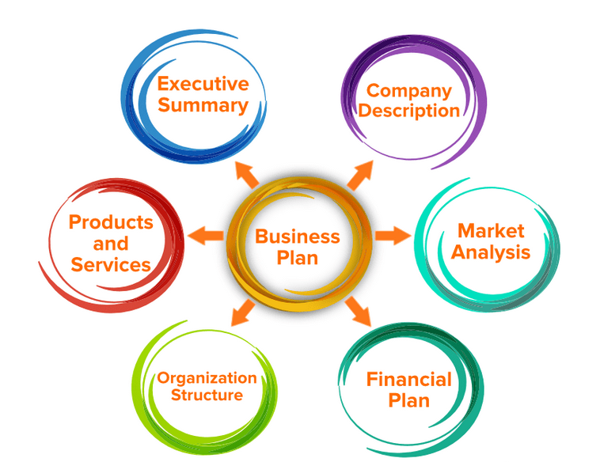
Key steps for writing a business plan
Step 1. Executive summary
Step 2. Company overview (background and history)
Step 3. Products and services
Step 4. Customer and Market Analysis
Step 5. Marketing and Sales strategy
Step 6. Management structure
Step 7. Financial planning, and a budget
Source: https://ncube.com/blog/how-to-write-startup-business-plan/

Slide 9
Key steps for writing a business plan
Step 1. Executive summary
It is an overview of the organisation’s purpose and goals. It cover an outline of the products and/or services the organisation intends to introduce into the market, and how these will “solve a problem”.
It includes a description of the target market, a brief competitors’ analysis, viability justifications through financial projections and, last but not least, the “ask”, i.e. funding requirements, if the organisation is planning to acquire finance.
Quick takeaway:
It is a snapshot of the entire business plan and aims to present and convince the end reader about the business idea; think of it as the “elevator pitch”.
Ideally, it is only one to two pages and although it comes first in order, business advisors suggest that organisations write it last.
It can act as a stand-alone document; investors usually read only the executive summary and if they find it interesting they will request to have the detailed plan.

Slide 10
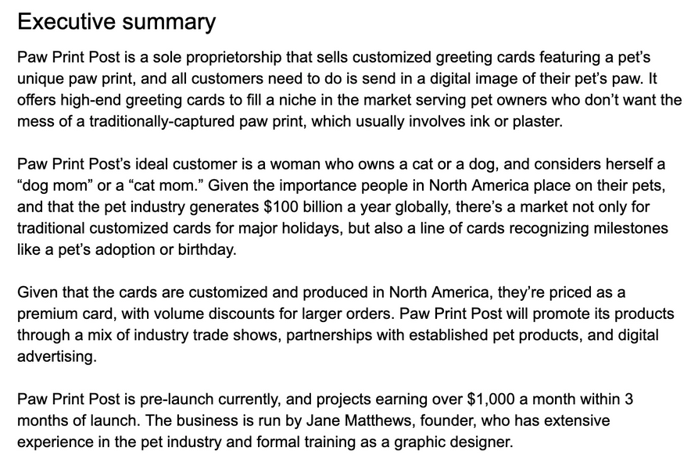
Key steps for writing a business plan
overview of the organisation
description of the target market
how these will “solve a problem”
financial projections
Source: https://www.shopify.com/blog/business-plan-examples

Slide 11
Key steps for writing a business plan
Step 2. Company overview (background and history)
In case of an establish business, this section provides an overview of the business, including its vision, mission and values as well as the legal structure.
It covers the core expertise, a brief description of the existing products/services, the team structure and the qualitative and quantitative success of the organisation over the years.
In the case of a start-up company, this section provides answers to the following questions:
What the start-up will provide?
What the needs will be, to run the business?
Who will service the customers?
Who the customers are?

Slide 12
Key steps for writing a business plan
Step 2. Company overview (background and history)
Source: https://www.shopify.com/blog/business-plan-examples

Slide 13
Key steps for writing a business plan
Step 3. Products and services
The products and services section is more than just a list of what the organisation is planning to provide. You should describe the problem you are planning to solve with the particular product or service and how you will go about it.
Describing how the business’ products and services will differ from the competition is important.
In case of a non-existent market, describing why the product and/or service will be needed is critical, especially if the business plan will serve external purposes, i.e. for acquiring funds or finding partners.
Therefore, you should explain the nature of the product, its uses, and its value, etc., whilst showcasing the quality, value, and benefits you will offer through this launch.

Slide 14
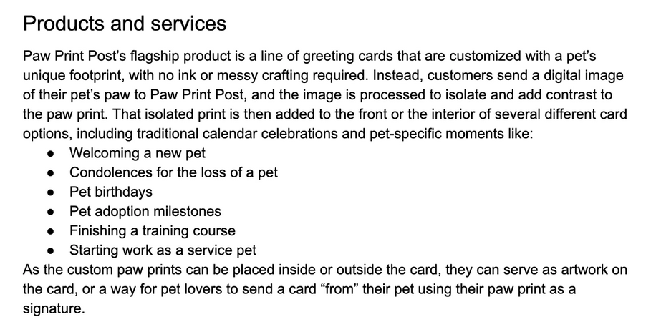
Key steps for writing a business plan
Step 3. Products and services
In this section, you can include pricing, product lifespan, and benefits to the consumer as well as information about the production and manufacturing processes, any patents or R&D or proprietary technology the business may be using.
In addition, you can provide an overview of the next steps needed to be accomplished in order to get the product or service ready to sell. Important milestones such as taking on pre-orders, need to be outlined here.
Source: https://www.shopify.com/blog/business-plan-examples

Slide 15
Key steps for writing a business plan
Step 4. Customer and Market Analysis
A successful business plan includes the following under this section:
Industry Description and Outlook: Includes background information about the industry, its challenges, its size, growth patterns and future outlook.
Target Market: Includes demographic information of the target audience, including age, gender and level of earnings. In this section, organisations assess the size of their potential market, how much it might spend, and how they will reach their potential customers.
Market Need: You can introduce their competitive advantage here. Refer to the below:
What factors influence the need for the product and/or service?
Did the need exist before or is the organisation trying to create it
Why will customers want to do business with the organisation, possibly choosing it over someone else?
Market Growth: You should make sales projections and know what the business may look like down the road. “Have the number of people in your target market been increasing or decreasing over the last several years? By how much per year?”

Slide 16
Key steps for writing a business plan
Step 4. Customer and Market Analysis
Market Trends: You should think about the types of changes that could affect the specific market they are interested in.
Is there a shift to more natural or organic ingredients that might impact your business?
How might energy prices figure in?
The easy availability of the internet and smartphone technology?
Market Research Testing: It assists you figure out where you stand in the market, including the viability of your potential product and/or service.
Competitive Analysis: This can be achieved by performing a SWOT analysis
Barriers to Entry: You should be clear on what barriers exist, if any, in the market you want to enter.
Do you have technical knowledge that’s difficult to get?
A specialized product no one else can manufacture
A service that takes years to perfect?
Regulations: If operating in an industry covered by regulations, you need to consider how these regulations apply to your business and how you will comply with them.

Slide 17
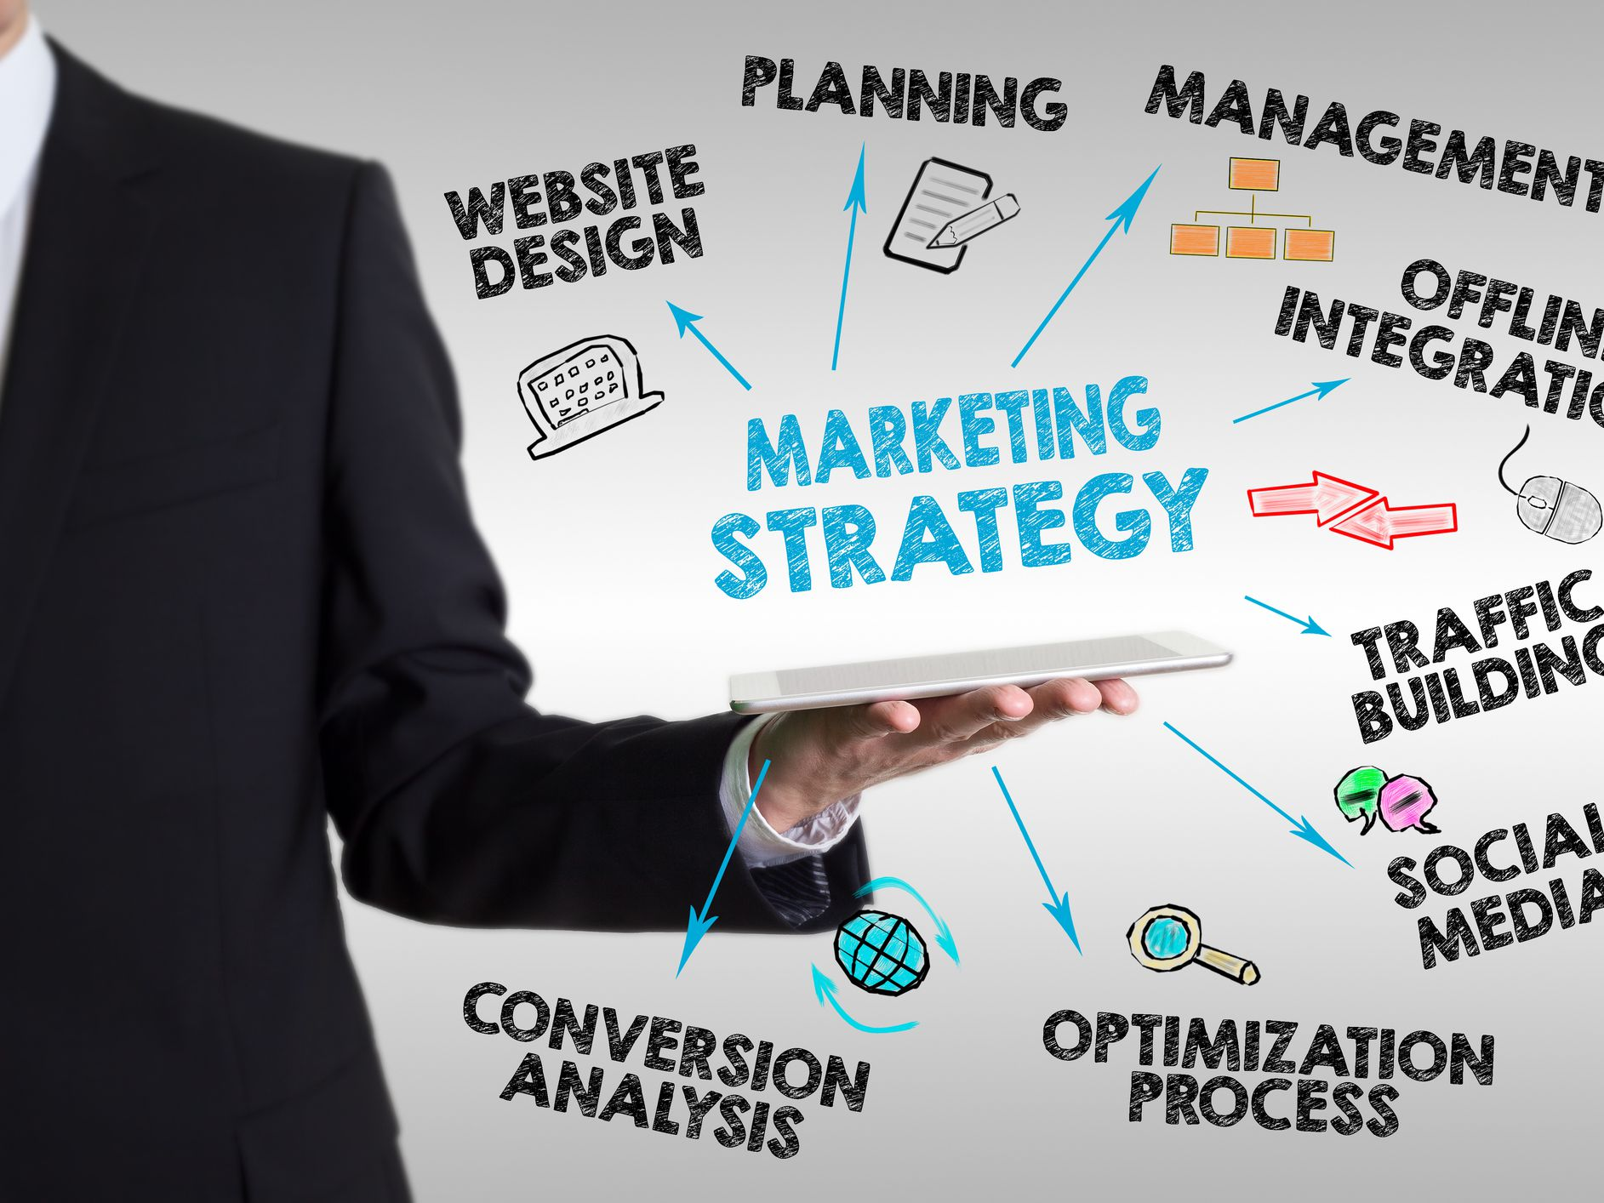
Key steps for writing a business plan
Step 5. Marketing and Sales strategy
Once the market is analysed, the competitors are assessed and the customers' needs are identified, you should proceed with the development of an initial marketing and sales plans.
This section discusses the methods the organisations will use to promote its products and/or services and track the results and overall success.
It involves understanding where and how you plan to sell your products and/or service and which sales targets you have.
It should include solid examples, such as hiring a number of sales representatives to sell in the field, open one or more physical shops or set up an online store.
Source: https://www.thebalancesmb.com/writing-a-business-plan-1794231

Slide 18
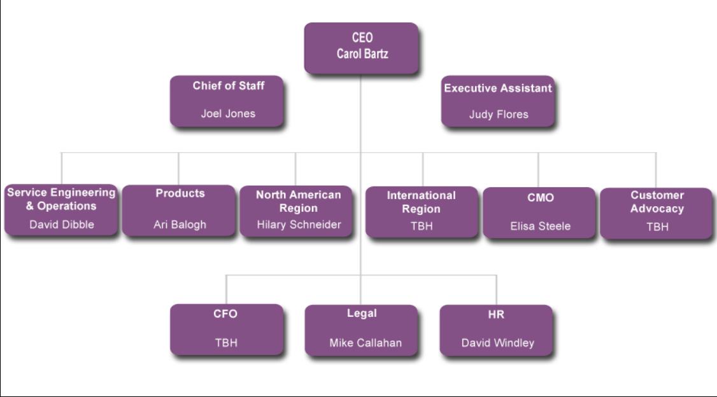
Key steps for writing a business plan
Step 6. Management structure
Management team is responsible for establishing the objectives and goals of the business and for enforcing strategies that focus on achieving those goals.
The business plan should include the positions in the company and definitions for each position, including their roles and responsibilities, as well as the reporting structure for each role.
In cases of start-up companies, which might not have any employees, it is advisable to have a list of roles that could be more idealistic to the culture and vision of the organisations.
All businesses should demonstrate a clear understanding of workflow and how it will be handled through every phase of growth and expansion.
Source: http://www.nicholascoriano.com/2013/09/business-plan-management-summary.html

Slide 19
Key steps for writing a business plan
Step 7. Financial planning, and a budget
It answers the question “Can the organisation make a profit?". Business financials for most start-ups are less complicated, and a business degree is not required to build a solid financial forecast.
A typical financial plan will include:
Sales and revenue projections: It is a monthly sales and revenue forecast for the first 12 months, and then annual projections for the remaining three to five years.
Profit and loss statement: It states the revenue and expenses and shows if the business is making a profit or taking a loss at a given period of time.
Cash flow statement: It is a projection of cash receipts and expense payments and shows how and when cash will flow through the business at any given point.
Balance sheet: It describes the company’s cash position including assets, liabilities, shareholders, and earnings retained to fund future operations or to serve as funding for expansion and growth. It indicates the financial health of a business.

Slide 20
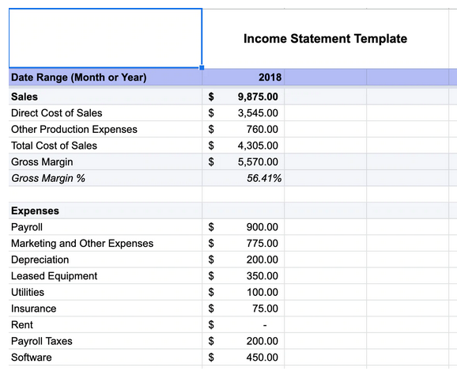
Key steps for writing a business plan
Step 7. Financial planning, and a budget
A typical financial plan will include:
Operating Budget: It is a detailed breakdown of income and expenses and provides a guide for how the company will operate from a monetary point of view.
Break-Even Analysis: It is a projection of the revenue required to cover all fixed and variable expenses. It shows when, under specific conditions, a business can expect to become profitable.
Source: https://www.shopify.com/blog/business-plan-examples

Slide 21
KEY POINTS
Which are the key points of Business Plan?

Slide 22
KEY POINTS
Business Plan is drafted by any organisation; whether that is a start-up or well established.
It is prepared both for internal and external purposes. Therefore, an important question to answer before drafting the business plan is “Who will the reader be?” and “What does the organisation want the reader’s response to be?”.
The plan should be concise and allow the reader – whoever that is; employee, banker, potential investor – to gain an understanding of the organisation, its goals and plans.
Business Plan is a dynamic document, and therefore, needs to revisited and updated on a regular basis depending on market conditions and changes in the business structure, goals and objectives and operations.
According to a study (Brinckmann, J., Grichnik, D., & Kapsa, D. (2010). Should entrepreneurs plan or just storm the castle? A meta-analysis on contextual factors impacting the business planning–performance relationship in small firms), organisations, who experienced over 92% growth in sales from one year to the next usually had business plans. In addition, 71% of the fast-growing businesses have a business plan.

Slide 23
KEY POINTS
Think about the key points in this module 6.
Reflect on what you have learned in today’s sessions and try to identify the new facts that you did not know before today.

Slide 24
"The European Commission's support for the production of this publication does not constitute an endorsement of the contents, which reflect the views only of the authors, and the Commission cannot be held responsible for any use which may be made of the information contained therein.” Project Number: 2020-1-UK01-KA226-VET-094435

