Slide 1
IO1: In-service Training Programme Module 4: Best practices on Circular Economy and Social Entrepreneurship– PPT3

Slide 2
Module 4: Contents
1
Good practices in the food production sector: Espigoladors and Karakeleko Organic Farm
2
Good practices of product as a service: Inwit and Repack
3
Good practices in energy sector and resources recovery: Energy4all, Dycle and Retalhar

Slide 3
OBJECTIVES
KNOW
UNDERSTAND
UNDERSTAND
Know good practices of social enterprise in the circular economy
Understand the added value of social enterprises
Understand the circular business models

Slide 4
Renewable energy and circular economy
The circular economy is not only about waste management but also about the use of clean energy such as wind or photovoltaic energy as a driver towards sustainable energy production and consumption as one of the fundamental principles underpinning the circular economy.

Slide 5
Good practice: Renewable energy
Energy4all – Green energy cooperative

Slide 6
Energy4all – Green cooperative energy(UK)
https://energy4all.co.uk/
Energy4All supports a family of 30 independent renewable-energy co-operatives. Our Co-operatives have 16,880 individual members.
Founded by the Baywind Energy Co-operative (the UK’s first renewable energy co-operative) in 2002, Energy4All demonstrates the power of co-operation in the renewables sector.
They work with communities to develop innovative renewable energy projects, they then raise the funds those projects need to go forward, they bring high-quality project managers to support the construction process and finally they work with directors to help them manage the projects over the long-term.

Slide 7
Energy4all
https://energy4all.co.uk/
MISSION
They have a two-fold mission: to support the UK’s transition to a low carbon energy systems; and to do this in a way that offers an opportunity for ordinary people to make a tangible contribution to tackling climate change.
HOW DO THEY WORK
They work with communities that want to develop co-operatively, genuinely community owned renewable energy. They help those communities develop a successful business case, and support projects through planning applications. The aim is to create balanced, independent boards with local people to oversee each new co-operative. Energy4All then helps the communities raise funds through public share and bond offers, brings the technical expertise to build projects to time and budget and then manages their continued operation. A core feature is that member returns on capital are capped in accordance with co-operative principles enabling surpluses to be applied to support the mission.

Slide 8
Energy4all
https://energy4all.co.uk/
RENEWABLE ENERGY SOURCES
Energy4All co-ops cover a range of technologies from wind and solar (ground-mount and roof-mount) to community heat and hydro schemes.
LANDOWNERS AND DEVELOPERS
The involvement of communities in the ownership and operation of renewable energy projects is set to grow. Landowners looking to develop projects on their land may wish to consider involving the local community in ownership of the project, either through full ownership or through a stake in the project.
Whether projects are wholly-owned by the community or the ownership shared with a developer or landowner, individual membership of an Energy4All co-operative usually starts at £250, so almost everyone can join a green energy co-operative and the maximum legal investment is £100,000. The co-op then builds or purchases a share of the generation project and members receive a fair return on their investment from the sale of green electricity with some of the profits also granted to a community fund.

Slide 9
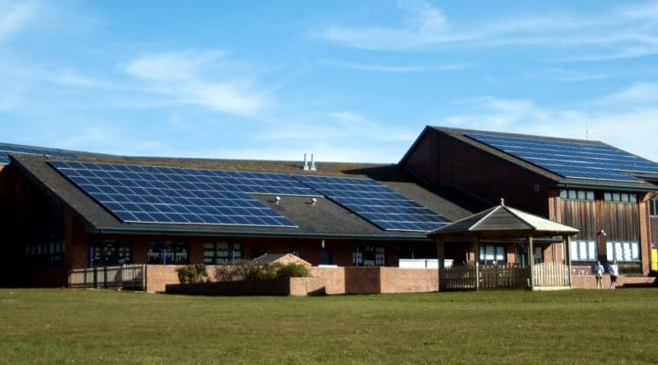
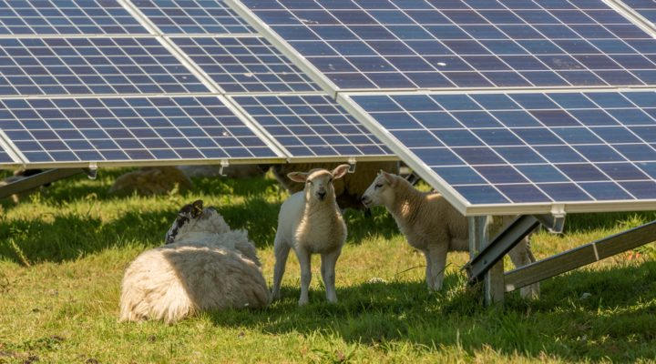
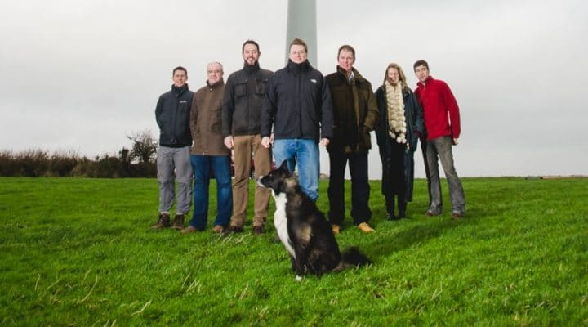
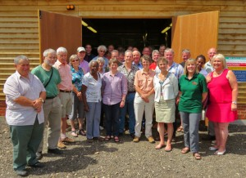
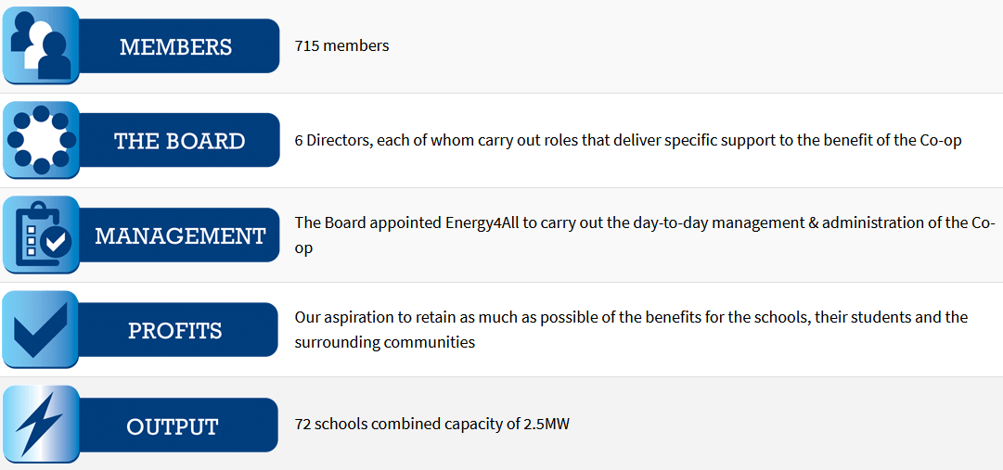
Energy4all
SOME COOPERATIVES OF THE GROUP
https://energy4all.co.uk/
West Solent Solar Cooperative
Drumlin Wind Energy Co-op
The Schools Energy Cooperative
Springbok Sustainable Wood Heat Co-operative

Slide 10
QUESTIONS
How do they involve the local community?
Why is it a social enterprise?
How do they apply the circular economy?
What other benefits have this system?

Slide 11
Good practice: Resource recovery
Dycle

Slide 12
Dycle (Berlin, Germany)
https://dycle.org/en
DYCLE is a fundamentally new way of how baby diapers are to be produced, used and recycled, or rather upcycled, when they are no longer a waste but a nutrient for plants, transformed into fertile soil.
The project will create small communities of around 100 families each living in the same neighbourhood, meeting regularly at the diapers distribution/collection points, planting fruit trees together, living their lives in a more connected way. We believe that many people’s small change in everyday life can bring bigger changes afoot – strengthening communities from the bottom up.

Slide 13
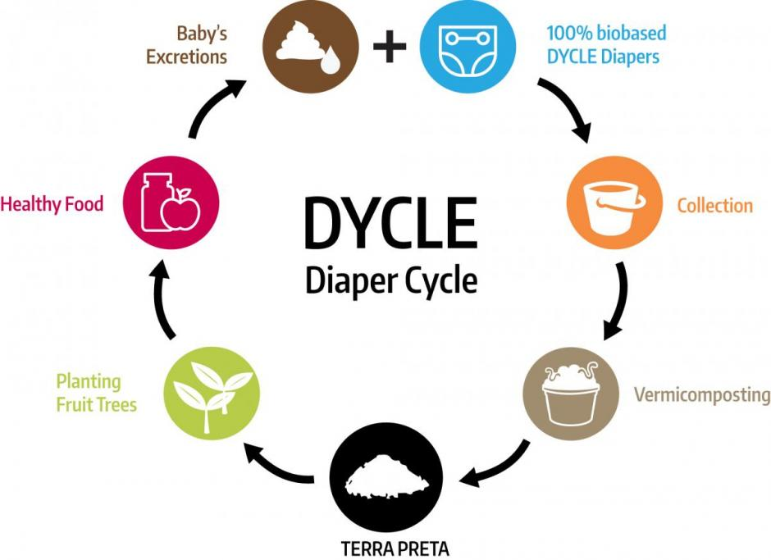
Dycle (Berlin, Germany)
https://dycle.org/en
CHALLENGE
Disposable diapers are a known environmental hazard comprising up to 10% of household waste. Each child produces around 500kg of diaper waste in their first two and half years of life that translates into around 1400 litres of crude oil used for plastic components according to DYCLE’s estimations.
The CO2 and methane gas footprints are high. Just the diapers impact is 500kg of CO2 emissions per child, without taking into account transportation, packaging and other.
SOLUTION
DYCLE supports parents who want to take a sustainable approach by using compostable diapers, through a diapers collection system and converting diapers waste into black soil, which will subsequently be used for growing trees and plants locally. As a diaper is full of baby waste, it contains excellent nutrients in a form of phosphates and nitrogen, and it degrades into hygienic and fertile black earth.
Harvest from the trees could be procured for baby food and juice production, thus closing the nutrients and materials cycle of baby diapers.

Slide 14
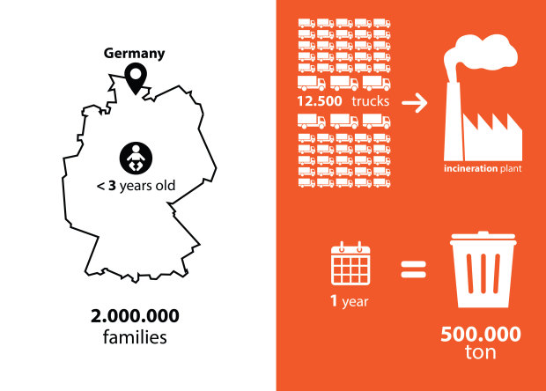
Dycle (Berlin, Germany)
https://dycle.org/en
ESTIMATIONS
DYCLE estimates that a 1000kg of black earth can be produced from one year’s supply of diapers from a single child.
Watch the video in the website!
BABIES HEALTH
Their first concern is health of the babies. That is why we have strict criteria for the diaper materials (e.g. Non-chemically treated absorption material, Non food source, 100% renewable source, non-irritant). At the same time we studied carefully how these materials could support the fertilizing top soil quality in the end. When we realized that there was no diaper available in the market that met our criteria, we decided to combine our extensive search for materials into a product design that generates an extraordinarily rich soil.

Slide 15
QUESTIONS
How do they involve the local community?
How do they apply the circular economy?
What can be their social and environmental impact?

Slide 16
Good practice: Textil recovery
Retalhar (São Paulo, Brazil)

Slide 17
Retalhar (São Paulo, Brazil)
https://www.retalhar.com.br/
CIRCULAR ECONOMY BUSINESS MODEL
Retalhar specialises in the reverse logistics of corporate uniforms and then refurbishing or repurposing them into new products.
This is done on a contract basis to return the waste (or rather ‘resource’) back to the organisation that produced it in the first place.
Through innovative services, they make the disposal of the company's professional uniforms a unique success story in the circular economy!

Slide 18
Retalhar (São Paulo, Brazil)
https://www.retalhar.com.br/
SOCIAL IMPACT
For them it is a principle: if the structuring of responsible waste management generates work and income, let opportunities be created beyond the simple creation of jobs. They work in partnership with highly effective and efficient cooperatives, valuing and empowering entrepreneurs and workers whose initiatives contribute to human development.
The uniforms are delivered to Retalhar who employ an ex-offender to triage the items and ensure things like company logos are secured (destroyed or returned) and then use a third party for laundry.
Retalhar then works with six women’s seamstress collectives to perform the refurbishing or repurposing. The collectives are typically enterprising women that have learned sewing skills from a weekend training course run by a local NGO, this, ensuring good regular income for the women.
They contribute to achieving the following Sustainable Development Goals:

Slide 19
Retalhar (São Paulo, Brazil)
https://www.retalhar.com.br/
PURPOSE
Retalhar integrates textile life by using waste reuse as a tool to enhance people.
MISSION
To enable the responsible management of textile waste through innovative and inclusive solutions, generating positive socio-environmental impact.
VISION
To be a reference in socio-environmental innovation in Latin America's textile chain until 2023, contributing so that all textile waste generated in the world has its useful life extended.
VALUES
Restlessness, collaborative autonomy, transparency, high spirits and trandisciplinarity.

Slide 20
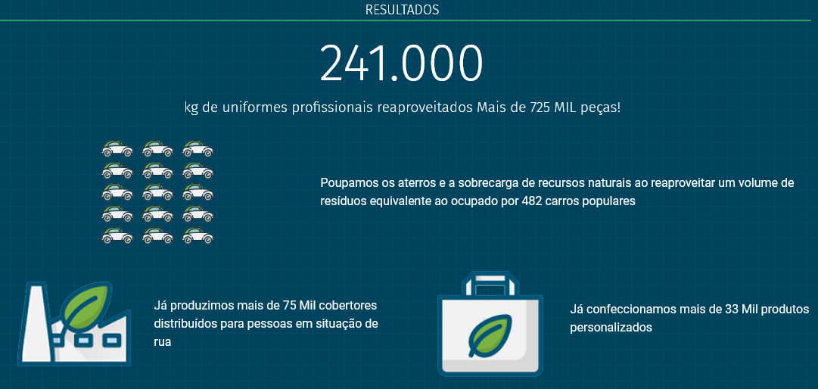
Retalhar (São Paulo, Brazil)
kg of professional uniforms are reused. More than 725,000 pieces
We save landfill sites and the burden on natural resources by reusing a volume of waste equivalent to that taken up by 482 cars.
We have produced more than 75,000 blankets distributed to the homeless.
We have made over 33,000 personalised products

Slide 21
QUESTIONS
How do they involve the local community?
How do they apply the circular economy?
Which is the social and environmental impact?

Slide 22
"The European Commission's support for the production of this publication does not constitute an endorsement of the contents, which reflect the views only of the authors, and the Commission cannot be held responsible for any use which may be made of the information contained therein.” Project Number: 2020-1-UK01-KA226-VET-094435

