Slide 1
IO1: In-service Training Programme Module 4: Best practices on Circular Economy and Social Entrepreneurship– PPT1

Slide 2
Module 4: Contents
1
Good practices in the food sector: Espigoladors and Good Edi
2
Good practices in product as a service: Inwit and Repack
3
Good practices in energy sector and resources recovery: Energy4all and Dycle

Slide 3
OBJECTIVES
KNOW
UNDERSTAND
UNDERSTAND
Know good practices of social enterprise in the circular economy
Understand the added value of social enterprises
Understand the circular business models

Slide 4
Social entrepreneurs and circular economy
Social Entrepreneurs (SE) play a significant and unique role in creating change in a country’s economy. The role played by SE’s is often difficult to measure because there is a systematic social change over the period of time. Social Entrepreneurs, according to Schwab Foundation, helps to create partnerships, improved visibility, easy access to funds and an increased knowledge of global affairs. This enables many political and business leaders to set up social funds and start social activities within their enterprises.
On the other hand, today’s buyers are demanding an entirely new relationship with the businesses they choose. Just providing a good product isn’t enough anymore. The millennial generation is looking to partner with brands that stand for something meaningful.

Slide 5
Bridging circular economy and social enterpreneurship
Across industries, a compelling financial case is emerging for shifting from linear to circular models of production and consumption. To capture circular value and pivot to new areas of growth, most industries are adopting a dual approach: applying circular models to their existing value chains, while gradually altering the way they do things today.
Bridging circular economy and social entrepreneurship has one main goal: create innovative, sustainable and long-term resilient local societies and economies which understand and respect the environmental boundaries.

Slide 6
Bridging circular economy and social enterpreneurship
The dominant economic system is facing the start-up of social enterprises, with business model that are more inclusive, responsible and beneficiary, demonstrating an example where a profitable economic activity does not impair the environment and empowers people in local communities .
Social enterprises with a circular business model can best address local environmental and social issues, encouraging circular changes throughout society.

Slide 7
Good practice: circular economy + social enterprise in the food production sector
Espigoladors

Slide 8
Espigoladors (Catalonia, Spain)
https://espigoladors.cat/en/
Fundació Espigoladors is a non-profit organisation founded in 2014 which fights against food waste and losses, while empowering people at risk of social exclusion from a transformative, participative, inclusive and sustainable way.
Mission: They act upon three social challenges:
developing a replicable and transferable model able to impact food waste reduction,
enhancing access to an adequate diet and
generating new opportunities for people at risk of social exclusion.

Slide 9
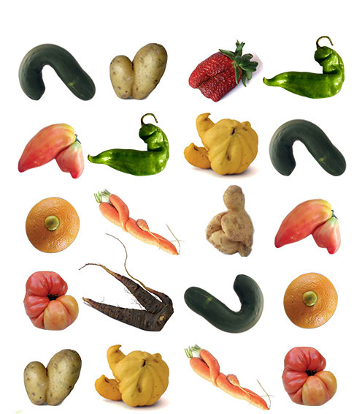
Espigoladors (Catalonia, Spain)
https://espigoladors.cat/en/
HOW THEY DO IT
In Espigoladors they give second opportunities to ugly and imperfect fruits and vegetables and to beautiful people.
Gleanings
They harvest fruits and vegetables that are not suitable for the market through gleanings with the help of volunteers.
Donation
Most of the fruits and vegetables that they collect are distributed for free to social entities, which work towards guaranteeing an adequate and dignified diet for people in vulnerable situations.
Transformation
They transform the other recovered produce into preserves while providing job opportunities to people at risk of social exclusion.
Awareness
They create a citizen movement through raising awareness and education, promoting a change of social consciousness towards a culture of making the most of food.

Slide 10
Espigoladors (Catalonia, Spain)
https://espigoladors.cat/en/
GLEANINGS
In Espigoladors, they want to recover and dignify the gleaning activity, an ancient practice with ancestral roots which consists in the harvest and collection, through an agreement with the farmer, of fruits and vegetables which are discarded from the commercial market for surplus production, diminishing of sales or aesthetic questions.
Thus they contribute to reducing the food waste and losses while making the task of the primary sector visible, as well as raising awareness about the value of food.
They organize gleanings directly in the fields of food which cannot be sold and we distribute them to social entities in order to provide access to healthy, nutritious food to people in vulnerable situations.

Slide 11
Espigoladors (Catalonia, Spain)
https://espigoladors.cat/en/
COMMITMENT WITH THE SUSTAINABLE DEVELOPMENT GOALS (SDGS)
The actions promoted by Espigoladors are well aligned with some of the SDGs, adopted in 2015 by United Nations in order to eradicate poverty, protect the planet and ensure prosperity for everyone as part of a new sustainability development global agenda.
CIRCULAR ECONOMY
At the same time, Espigoladors model is closely bound up with the circular economy principles, a new paradigm change aiming to extend product’s lifespan and maximize their use, while reducing waste generation.
A NETWORK of local farms and volunteers
They get curious, compromised people with willingness to learn, who want to contribute to the fight for better food usage, who want to share experiences and work hands-on with the land.
We look for farmers who want to contribute for a better food usage with them, applying a coherent solution with the environment and social context.

Slide 12
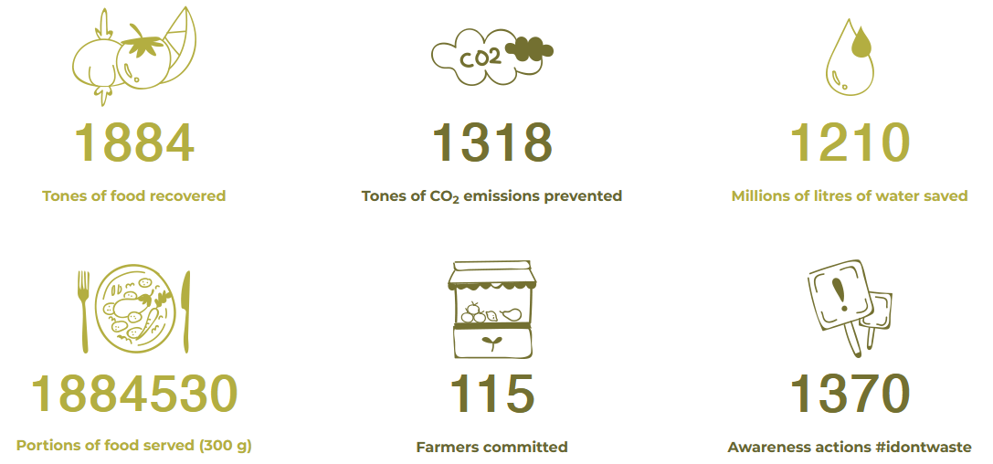
Espigoladors (Catalonia, Spain)
https://espigoladors.cat/en/
THEIR IMPACT

Slide 13
QUESTIONS
Watch this video: https://www.youtube.com/watch?v=6W9ec1HK4UE
How does Espigoladors involve the local community?
Why is it a social enterprise?
How do they apply the circular economy?
Lessons learned:
• Measures for ecological and social sustainability can be combined in the circular economy model
• An ancient practice combined with new ideas can fulfill requirements from the 21 century
• A large network with different institutions , businesses , social entities and the agricultural sector allow such a big impact

Slide 14
Good practice: circular economy + social entrepreneurship in the food sector
Good Edi

Slide 15
Good Edi (Australia)
https://good-edi.com/
Each year in Australia 1 billion takeaway cups are being sent to landfill.
They felt that the solution to this pressing issue needed to be waste-free. Not just shift the problem elsewhere. Unfortunately, most eco-friendly cups require special commercial facilities and specific environments to break down over time. Most still end up in a landfill.
Catherine and Aniyo, founders of Good-Edi, decided to take their 20 years of experience in food processing and do something good. Turns out it was their destiny to do this one edible takeaway cup at a time.
They created the Good-Edi cup to provide a sustainable and eco-friendly choice when opting for a single-use takeaway cup.

Slide 16
Good Edi (Australia)
https://good-edi.com/
In this interview, Catherine Hutchins and Aniyo Rahebi discuss their key learnings through becoming successful social entrepreneurs and the devastating environmental impact of takeaway coffee cups.
https://www.impactboom.org/blog/2021/8/16/catherine-hutchins-and-aniyo-rahebi-on-creating-environmental-sustainability-through-waste-free-edible-coffee-cups
You can also hear this podcast:

Slide 17
Good Edi (Australia)
https://good-edi.com/
“Our first challenge was finding a supplier who could produce these cups as an industrial product, where we could get repetitive quality and the same functionality.”
Although they are all about infrastructure waste management, you can see that a small start-up is making a fantastic impact in this space by basically turning waste into a resource.

Slide 18
QUESTIONS
Why is it a social enterprise?
How do they apply the circular economy?
What other benefits offer Good Edi?

Slide 19
"The European Commission's support for the production of this publication does not constitute an endorsement of the contents, which reflect the views only of the authors, and the Commission cannot be held responsible for any use which may be made of the information contained therein.” Project Number: 2020-1-UK01-KA226-VET-094435

