Slide 1



IO1: In-service Training Programme
Module 1: Entrepreneurship and Social Entrepreneurship – PPT1

Slide 2

Module 1: Contents
1
Entrepreneurship and social entrepreneurship
2
Identifying the problem in your community
3
Defining the vision and mission of a social enterprise

Slide 3


Module 1 OBJECTIVES
KNOW
KNOW
UNDERSTAND
IDENTIFY
Know the concept of entrepreneurship
Know the competences of an entrepreneur
Understand the added value of social enterprises
Identify the vision and mission of a social entreprise

Slide 4

Background
The European Commission's Entrepreneurship Action Plan 2020 (2013) highlights the need to train people in entrepreneurial skills in order to promote business growth and start-ups.
In the current context of global crisis and climate change, it is becoming increasingly important to consider the social and environmental aspects of entrepreneurship.
New entrepreneurs can contribute with their companies to society's growing demand, which is an added value for social enterprises that reinvest part of their profits in projects to improve our society and reduce environmental impacts. Through these actions, companies can build customer loyalty, which is increasingly interested in participating in a more social economy.
For these reasons, we emphasize the social entrepreneurship as the best way for young people to collaborate with others and undertake a business.

Slide 5




SOME DEFINITIONS
ENTREPRENEURSHIP?
LEADERSHIP?
ENTREPRENEURIAL LEADERSHIP ?

Slide 6
SOME DEFINITIONS
ENTREPRENEURSHIP
LEADERSHIP
ENTREPRENEURIAL LEADERSHIP ?
Capacity to act upon opportunities and ideas, and transform them into value for others. The value that is created can be financial, cultural or social” (European Union, 2018)
Strategic vision coupled with the ability to influence and motivate others through the systems, processes and culture of an organisation (Roomi and Harrison, 2011)

Slide 7
SOME DEFINITIONS
ENTREPRENEURSHIP
LEADERSHIP
ENTREPRENEURIAL LEADERSHIP
Capacity to act upon opportunities and ideas, and transform them into value for others. The value that is created can be financial, cultural or social” (European Union, 2018)
Strategic vision coupled with the ability to influence and motivate others through the systems, processes and culture of an organisation (Roomi and Harrison, 2011)
Fusion of these two elements: having and communicating the vision to engage teams to identify, develop and seize opportunities for competitive advantage

Slide 8


Entrepreneurial skills and competences
COMPETENCES
Competences can be defined as the combination of observable and measurable knowledge, skills, and personal attitudes
AN ENTREPRENEUR SHOWS 3 KEY COMPETENCES
• Knowledge: facts, truths and principles gained from formal training and/or experience.
•Skills: is a developed proficiency in mental operations or physical processes that is acquired through specialized training.
•Attitude: entrepreneurs should be passionate about their ideas, learn from failure and utilize their fear of failing to push themselves, be flexible, have a strong work ethic, and they must be able to show others they are truthful and honest.
SYMPLIFYING
skills can be learned, whereas competencies are mostly intrinsic to one’s personality. Throughout performing a job, an individual also gains expertise: personal experience, professional networks, language skills, etc.

Slide 9

TYPES OF ENTREPRENEURIAL SKILLS
Creative Thinking | LEADERSHIP
Entrepreneurs are known for “thinking outside the box”. They try solutions that most people either fail to consider or are too afraid to try Innovation Emotional Intelligence Ability to Understand Root Problems Identify Causes Brainstorming Technology Thinking Outside the Box Building a Team | Entrepreneurs often have strong leadership skills. They have great ideas and are skilled at getting buy-in from investors and employees. Persuasion Sales Tenacity Perseverance Collaboration Initiative Confidence Competitive

Slide 10
TYPES OF ENTREPRENEURIAL SKILLS
Risk-Taking | STRONG WORK ETHIC
Entrepreneurs often seem more comfortable with risk than are other leaders. Taking risks can lead to failures but also to success. Risk Management Pro Forma Statements Sales Forecasts Break-Even Analysis Experimentation Ongoing Improvement Self-Efficacy Growth Mindset Negotiation Analytical Stress Tolerance | A lot of long hours are required to launch something. To be successful, entrepreneurs must execute. Building Business Plans Consistency Diligence Project Management Focus Goal-Oriented Results-Oriented Work Independently

Slide 11
TYPES OF ENTREPRENEURIAL SKILLS
Agile/RIEP as key skills for a new economy | MORE ENTREPRENEURIAL SKILLS
Rapid Iterative Experimental Process (RIEP) is an agile approach to the product development process. With this approach, frequent experiments are deployed in an attempt to discover new, innovative ideas. Agile Management allows organisations to innovate and adapt successfully. Agility is closely related to the concepts of Lean and Systems Thinking and links to the circular economy mindset when it unlocks broader perspectives, stakeholders and energy for the kind of rapid holistic evolution needed for a green economy. | Business Storytelling Computer Skills Critical and Logical Thinking Decision Making Flexibility Interpersonal Communication Nonverbal Communication Planning Problem Solving Relationship Building Social Media Strategic Planning Team Building Time Management Vision, etc.

Slide 12
What do circular economy entrepreneurs have to change?
BREAK THE LINEAR ECONOMY PARADIGM
Scheel pointed out that circular economy entrepreneurs must break the linear innovation paradigm, opt for circular business model systems, and turn themselves into leaders who create conditions and systems..
SPECIALIZE IN UNUSUAL PROCESSES
In order to do this, they need to specialize in unusual processes to become systemic and circular entrepreneurs who generate sustainable wealth.
THE PURPOSE
The purpose of starting unusual new businesses is to transform an idea related to a problem, or a non-linear business initiative, into a circular business system of sustainable and extended value, which is financially profitable, has an attractive market, and is designed to participate in an economy aligned with the country’s sustainable growth.
CHARACTERISTIC TO ACHIEVE THIS GOAL
Disruptive innovation
A systemic approach
A vision of the circular economy
Knowledge and management of unusual processes

Slide 13

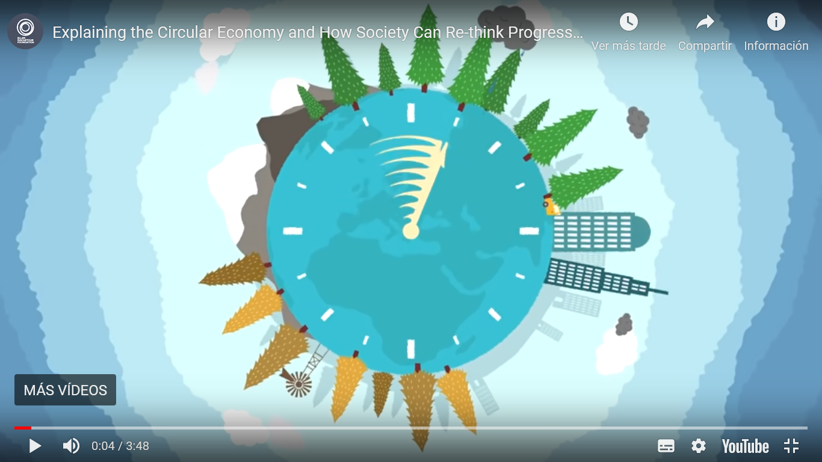
WATCH THIS VIDEO
Explaining the Circular Economy and how society rethink progress
https://youtu.be/zCRKvDyyHmI

Slide 14
EXAMPLES OF ENTREPRENEURS IN THE CIRCULAR ECONOMY
Reusables – Reusables is a container sharing platform for takeout food, coffee and more from your favorite stores.
Our stainless steel vessels can be used hundreds of times and are fully recyclable at end of life.
3F Waste Recovery – are a Newfoundland-based company working hand-in-hand with local fishers, farmers and foresters to extract premium quality, sustainable and natural ingredients from their by-products.
Teemill – Teemill is a tech-based fashion business that takes a more holistic view of the fashion industry, designing out waste at each step of the material supply chain, applying disruptive technology to minimise overstocking, and maximise material recycling.

Slide 15
SOCIAL ENTREPRENEURSHIP
DEFINITION
Social entrepreneurship is a process of building or transforming organisations to advance solutions to social problems, such as poverty, illness, illiteracy, environmental destruction, human rights abuses and corruption, to make life better for a great number of people (Borstein and Davies, 2010)
SOCIAL ENTREPRENEURS CREATE PUBLIC VALUE
pursue new opportunities, innovate and adapt, act boldly, influence resources out of their control and exhibit a strong sense of accountability.
CAN REDUCE SOME OF THE CHALLENGES
associated with conventional forms of business
ALIGNS WITH THE GROWING TREND OF YOUNG PEOPLE
becoming more socially and environmentally conscious

Slide 16

DIFFERENCES BETWEEN BUSINESS ENTREPRENEURSHIP (BE) AND SOCIAL ENTREPRENEURSHIP (SE)
How Are Profits Used?
(mission)
Who’s Investing in Your Entrepreneurship?
How is performance measured? (accountability)
WHATCH THIS VIDEO
Business Entrepreneurship vs Social Entrepreneurship:
https://www.youtube.com/watch?v=Mh1rXR40hyk
Configure the speed of the video to 0.75
DISCUSSION

Slide 17
DIFFERENCES BETWEEN BUSINESS ENTREPRENEURSHIP (BE) AND SOCIAL ENTREPRENEURSHIP (SE)
How Are Profits Used?
(mission)
Who’s Investing in Your Entrepreneurship?
How is performance measured? (accountability)
A BE uses their profits to grow the company and pay shareholders. You get involved in a BE for the sake of making money and increasing your personal wealth. Although SE engage in for-profit activities, part of their profits may be donated to charity or used for other philanthropic efforts. There may be no shareholders in a social entrepreneurship, and even the entrepreneur may not make much personal wealth from their business. Instead, it’s about the mission.
Many SE seek their first-phases of funding from philanthropists. Although these investors want to see a return-on-investment (ROI) they’re more likely involved in the business due to its social mission. A traditional, BE usually seeks capital from a venture capitalist firm — and they’re all about the ROI and nothing else
The social entrepreneur has greater challenges for measuring performance than the commercial one, who can rely on relatively tangible and quantifiable measures of performance (financial indicators, market share, customer satisfaction, and quality). A social enterprise is readily accountable to a higher number of financial and non-financial stakeholders and more varied, resulting in greater complexity in managing these relationships

Slide 18
SOCIAL ENTERPRISE
DEFINITION
A social enterprise is an enterprise whose main objective is to have a social or environmental impact rather than make a profit for their owners or shareholders. It operates by providing goods and services for the market in an entrepreneurial and innovative fashion and uses its profits primarily to achieve social or environmental objectives. It is managed in an open and responsible manner and, in particular, involve employees, consumers and stakeholders affected by its commercial activities.
SOCIAL ENTERPRISES ARE A NEW WAY OF DOING BUSINESS
Social Enterprises are business models set up to tackle social , economic or environmental issues
SOCIAL ENTERPRISE IS NOT A LEGAL STRUCTURE
it is rather a term describing a business that trades primarily for a social and/or environmental purpose. There are various legal forms that are used to incorporate social enterprises.
ARE BUSINESS THAT WANT TO MAKE A PROFIT
Similarly to traditional businesses aim to make a profit; however, it’s what they do with their profits that is different– reinvesting or donating them to create positive social change. It is business for the benefit of everyone involved, and when they profit, society profits.

Slide 19


key dimensions of a social enterprise
Source: A map of social enterprises and their eco-systems in Europe. Synthesis report. 2015

Slide 20
WHAT A SOCIAL ENTERPRISE DOES AND DOES NOT
A SOCIAL ENTERPRISE DOES | A SOCIAL ENTERPRISE DOES NOT
Makes its money from selling goods and services | Exist soley to make profits for shareholders
Covers its own costs in the long-term (though like any business, it may need help to get started) | Exist to make its owners very wealthy
Reinvesting profits (or part of them) back into the organisation to make a difference | Solely rely on volunteretinfg, grants or donations to stay afloat in the long-term (though, it may need this sort of help to get started
Pay reasonable salaries to its staff

Slide 21
PRINCIPLES OF A SOCIAL ENTERPRISE
Ultimately, being a social enterprise is about adopting a set of principles. These include:
Impact: Having a clear social and/or environmental mission (set out in your governing documents) and reinvesting much of your profits to further the social mission.
Finance/ Profits: Generating your income through products trade or services.
Ownership: Having a democratic and inclusive view of decision making in the organisation, including having strong governance, community involvement and a positive stakeholder engagement.
This is regardless of what form the organisation takes. So, if you have these in place – you are acting as a social enterprise.

Slide 22
INCOMES AND OUTCOMES OF A SOCIAL ENTERPRISE
A social enterprise can do many things:
Selling products: This can be everything, including innovative products.
Selling services: Social enterprises can deliver anything from consulting services, recycling, or property management to training, courier services, lawn maintenance, running cafes or restaurants, etc.
Income Generation: can generate profits from services and can sell such services to members of the general public, specific companies or government agencies.
Outcomes: The range of outcomes that can deliver range from employing people with learning difficulties, providing affordable psychology services to low income families, assist in helping young people find work, having an environmental positive impact, etc. The list is endless

Slide 23


What do Recreate do?
How is it achieved?
Which is their vision?
How do they help local businesses to produce less waste?
Who is it for?
How many members do they have?
Which is their business model?
What other services do they offer?
How much tones of waste was avoided to be delivered to landfill in 2017?
CASE STUDY
RECREATE
https://recreate.ie/

Slide 24
EXAMPLES OF SOCIAL ENTREPRENEURSHIP
Grameen Bank – This “bank of the poor” is a special type of creditor that offers micro-loans to impoverished people in developing countries. These small loans give people the means to be self-sufficient, and they’re almost always paid in full.
TOMS– this stylish footwear company was formed after their founder, Blake Mycoskie, visited Africa and was shocked to find most people couldn’t afford a pair of shoes. For every pair of TOMS sold, the company donates one pair of shoes to people in need.
Seventh Generation – along with producing cleaning and personal hygiene products that have a reduced harmful effect on the environment, this social entrepreneurship donates 10 percent of their pre-tax revenue to non-profits and other social entrepreneurships.

Slide 25


"The European Commission's support for the production of this publication does not constitute an endorsement of the contents, which reflect the views only of the authors, and the Commission cannot be held responsible for any use which may be made of the information contained therein.” Project Number: 2020-1-UK01-KA226-VET-094435

